Slide 1

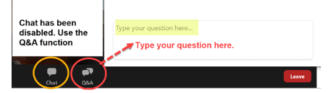

To attendees, please note:
Presently, we are in silent mode.
Chat is set for you to notify the panelists if you are having technical issues.
The “raised hand” feature is turned off.
Instead, use the Q&A option to enter questions for the presenters. The presenters will stop periodically to answer your questions or will address them after the webinar is over in a separate document.
A link to a brief survey will show in the browser when the webinar ends.
The slides and a video recording of the presentation will be available a few days after the webinar on the AAUW California website. More information to follow.

Slide 2

AAUW California
Lobby Days 2026
How to be an Effective
Lobby Days Advocate
March 23, 2026

Slide 3
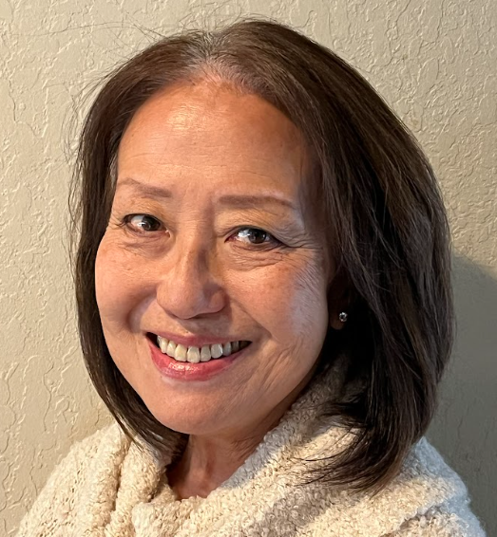
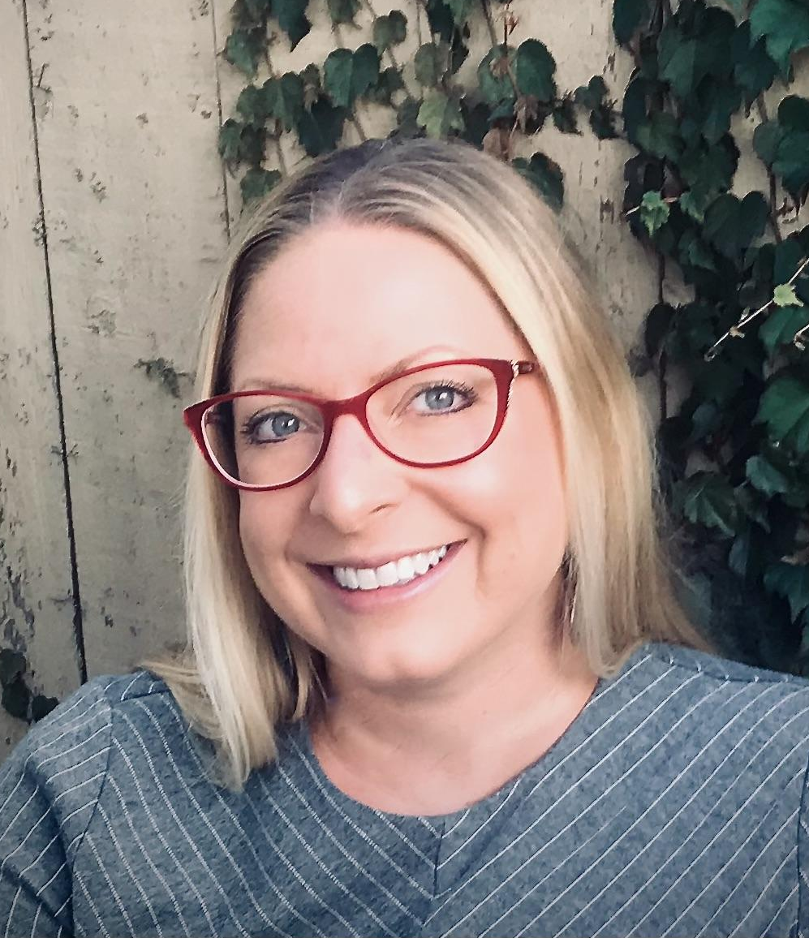
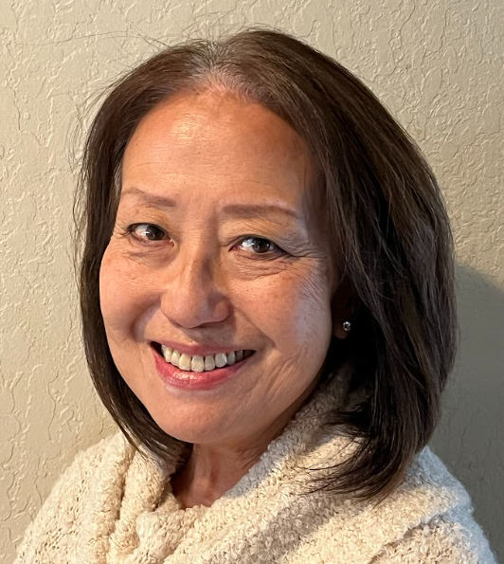
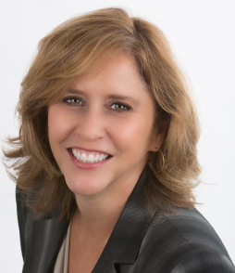
Welcome
Missy Maceyko Director, AAUW California Public Policy
Amy
Hom
Director, AAUW California Public Policy
Kathy
Van Osten
Legislative Advocate
Notes:
Amy (presents)

Slide 4
What We Will Cover Tonight
Lobby Days - An Overview
Purpose of Lobby Days
Meeting Overview, Dos and Don’ts
Meeting Scripts
How to talk about our three priority bills
All of the material we will cover tonight is posted on the AAUW California website: Lobby Days 2026 - Advocate for Bills to Advance AAUW Values - AAUW California
Notes:
Amy

Slide 5
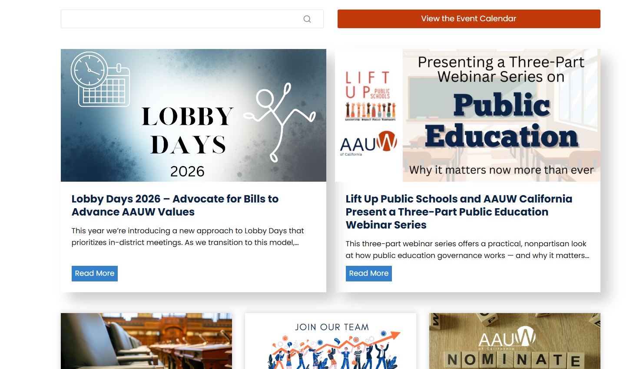
AAUW California Home Page
Notes:
Amy

Slide 6
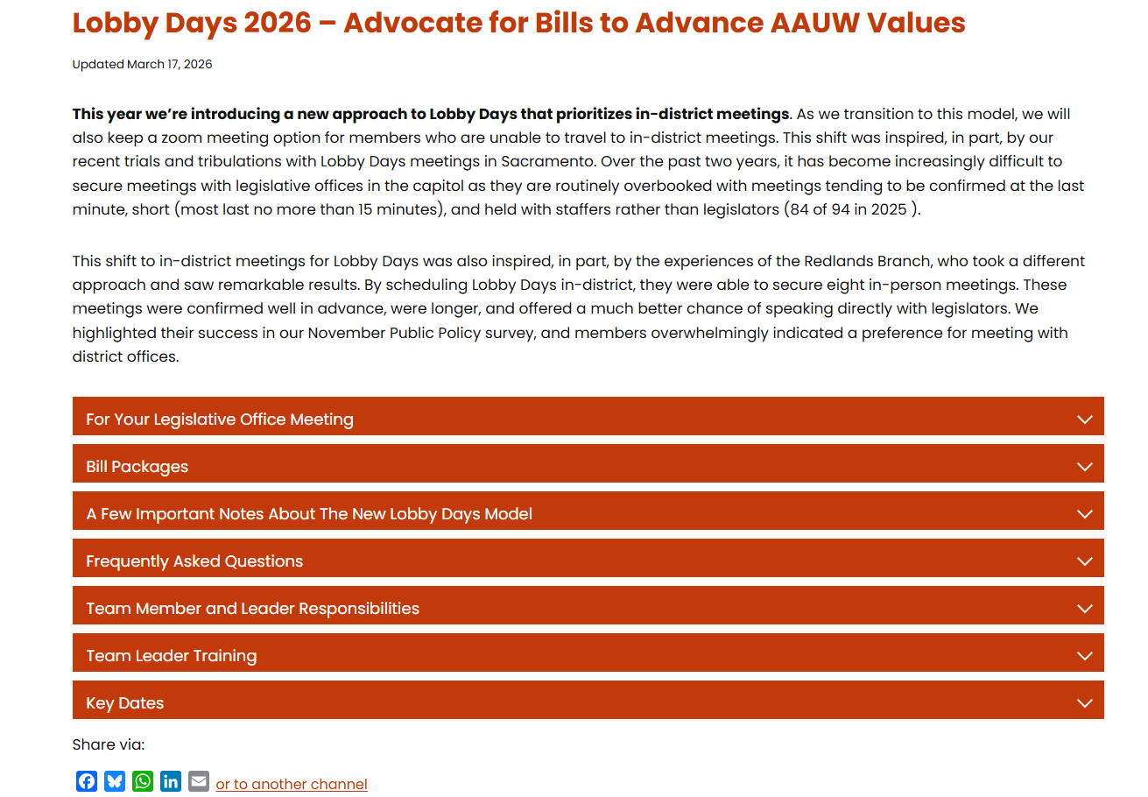
AAUW California Lobby Days 2026 Page
Notes:
Amy

Slide 7
Lobby Days 2026 - An Overview
This year we are trying a new approach to Lobby Days, with emphasis on in-district meetings. A Zoom option is also available for those unable to travel.
The shift was inspired by recent experience.
Meetings with the Sacramento offices have become very hard to schedule, with most meetings scheduled at the last minute, and most meetings held with staff rather than legislators (84 of 94 in 2025)
In 2025 the Redlands branch scheduled in-district meetings with great success. 4 of 8 meetings they held were with the legislator and not just staff.
AAUW members responded to a survey in November 2025 and indicated that they would like to follow the Redlands model and meet with district offices.
Notes:
Amy

Slide 8
Lobby Days 2026 - An Overview (cont’d)
This year there are 192 participants representing 64 branches.
They have been placed into 30 in-district teams and 13 Zoom teams.
Teams were formed based on:
Member’s preferred format (in-district vs Zoom)
Shared legislators
Branch members were kept together where possible
In-district team was given preference where a legislator is shared across in-district and Zoom participants.
A few people were assigned to two teams - an attempt to give everyone the opportunity to meet with both of their reps. If you can’t join one of the teams, just let the Team Leader know!
Altogether we will meet with 36 Senate offices and 60 Assembly offices.
Our hope is that more legislators will join us, especially in district office meetings.
Notes:
Amy

Slide 9
Lobby Days 2026 - An Overview (cont’d)
In-district Meetings:
March 27-April 17, 2026
Meetings are being scheduled by the Team Leaders
  Team Leaders: If an office is not responding to your requests, please reach out to their scheduler to ask for help. Find scheduler contact info here: CAPITOL CODEX: CROWDSOURCED #CALeg Spreadsheet - Google Sheets
  Be persistent! Call their office - “The squeaky wheel gets the oil.”
  If you continue having problems, reach out to publicpolicy@aauw-ca.org.
Zoom Meetings:
April 8-10, 2026
Meetings are being scheduled by AAUW California
Team Leaders: Look for calendar invites including Zoom links (coming over next 2 weeks)
For all meetings:
Team Leaders are responsible for communicating meeting details with team members.
Notes:
Amy

Slide 10
Purpose of Lobby Days
Lobby Days is an opportunity to:
Establish relationships with your legislative offices
Tell your legislators about AAUW, AAUW California, and your branch
Advocate on behalf of AAUW California’s priority legislation for 2026
Notes:
Amy

Slide 11
Meeting Overview
Meetings will last about 15-20 minutes. In-district meetings will be longer, depending on the legislator’s availability.
Team Leader makes introductions, presents overview of AAUW, AAUW California, and leader’s branch if in district. Team Leader thanks the legislator for their support of AAUW values (as applicable).
Other team members give an overview of their branch if in district and the team leader is out of district.
Members explain their assigned bill, and ask for a commitment of support.
Team Leader (or another member) thanks the legislator or staff, asks for a photo, and gets contact info for follow-up.
Notes:
Ginny

Slide 12
Some Do’s … Before the Meeting
Do some homework - know where the member stands on AAUW values.
Make sure you understand the bills.
Plan to use the talking points. You can paraphrase or shorten the script, but stay consistent with the main points.
If you have a relevant personal story, tell it - this can be very compelling.
Practice! Do a few run-throughs of your script to make sure you are comfortable, and coming in at the allotted time (~3 min for Team Leader Intro, ~2.5 minutes per bill)
If you are participating via Zoom: Make sure your equipment is working and there are no distractions.
Notes:
Amy

Slide 13
During the Meeting
RELAX! They’re just people!
Let them know if you are a constituent.
Let your pride in AAUW shine through.
Stick to your allotted time.
It’s okay to read from the talking points.
Give them time to ask questions and listen carefully to responses.
It’s okay to say “I don’t know.” Tell them you’ll find out and that someone will circle back. WRITE IT DOWN!
Ask if we can count on the member’s support.
Notes:
Amy

Slide 14
Some Don'ts
If you have been a campaign contributor DO NOT MENTION IT!
Don’t be late.
Don’t join your Zoom any earlier than 5 minutes before the meeting time. If you join too early, you will terminate the previous meeting that is in progress.
If the member or staffer is about to speak or is speaking, do not interrupt.
Don’t ramble.
Give your undivided attention to the meeting. No eating, drinking, or knitting during the meeting (no joke - we heard this happened last year!).
Notes:
Amy

Slide 15
Some “Don’t Forgets”
Team Leaders: at the start of the meeting, ask how much time they have. If they have a hard stop, you will need to keep your team moving fast - most importantly, to cover the three bills.
Be flexible.
  We may have last-minute changes beyond our control.
  Your member or staffer may be late.
  Your member or staffer may have to cut the meeting short.
  There may be technical glitches.
  Be courteous no matter what.
Make note of questions/concerns/responses.
Notes:
Amy

Slide 16
Team Leader Script
Good [morning][afternoon]. On behalf of AAUW California, thank you for taking the time to meet with us today.
My name is [ ], and I am from the [ ] branch of AAUW. These are my colleagues [introduce each person or allow them to introduce themselves, including their branch].
Before we get started, can you tell us how much time you are able to give us today?
May I ask if you’re already familiar with AAUW - the American Association of University Women?
(Pause and allow them to respond. If they are familiar, briefly fill in any gaps. If not, provide highlights.)
AAUW is a nationwide organization founded in 1881 and headquartered in Washington, D.C., with affiliates in all 50 states.
Here in California, we are known as AAUW California. Our state organization was established in 1921 and incorporated in 1956. Today we have 108 branches and about 8,500 members across the state.
AAUW’s mission is to advance equity for women and girls through research, education, and advocacy. One of our core values is ensuring equity for a diverse society.
Notes:
Ginny

Slide 17
Team Leader Script (cont’d)
If your branch is in the legislator’s district:
Our branch is located in your district, and [if appropriate] we appreciate the support you/the member has shown for issues we care about. I’d like to briefly share a few of the things our branch has been doing locally, such as [briefly mention 1-2 key programs or recent events].
If your branch is not in the legislator’s district but another team member’s branch is:
[Team member name]’s branch is here in your district, and she will briefly share some of the things her branch has been doing locally. (Invite the team member to briefly share 1-2 key programs or recent events.)
If no one is from the district:
I should mention that none of us are from your district. We were asked to meet with your office because this is an important district, and unfortunately no local members were available today.
Across California, AAUW branches engage in programs such as Tech Trek science camps for middle school girls, scholarships for women and girls, voter engagement efforts, and our School Board Project.
Notes:
Ginny

Slide 18
Team Leader Script (cont’d)
One of the exciting projects AAUW California is working on this year is the Teen Girls Reproductive Health Awareness Project.
Our Orinda-Moraga-Lafayette branch has been working with a group of local high school students to write a House Resolution, sponsored by Assemblymember Rebecca Bauer-Kahan, declaring September 2026 as Reproductive Health of Teen Girls Awareness Month.
It will encourage educators and health care providers to promote educational campaigns focused on reproductive health topics to teenage girls.
AAUW California is also conducting additional research on potential methods to educate youth about social media misinformation related to reproductive health.
Can I answer any questions for you about AAUW?
Notes:
Ginny

Slide 19
Team Leader Script (cont’d)
If the legislator is generally aligned with AAUW’s values:
Before we move to our priority legislation, we would like to thank you for your leadership and for supporting issues that advance equity for women and girls.
[If applicable:] We especially appreciate your “Yes” vote in 2025 on SB 771 and/or SB 418 which were AAUW California’s top priority bills last year.
See how the representative you are meeting with voted on these bills: Floor Votes - 2025 AAUW California "A" Priority Bills SB 418 and SB 771 - Google Sheets)
[If you are meeting with these offices, we would also like you to thank these legislators for authoring AAUW California's recent priority bills]:
Senator Henry Stern - SB 771 (2025)
Senator Caroline Menjivar - SB 418 (2025)
Assemblymember Maggy Krell - SB 1766 (2026) and SB 1845 (2026)
Assemblymember Dawn Addis - SB 1876 (2026)
Notes:
Ginny

Slide 20
Team Leader Script (cont’d)
If the legislator is not closely aligned with AAUW’s values:
Before discussing our priority legislation, we want to thank you for the work you are doing for the district, particularly [mention 1-2 relevant examples.]
While we may not always agree on every issue, we believe some of the bills we are supporting this year will be ones you will find worthwhile to support.
Transition to Bills
Each year, AAUW California develops a legislative agenda of roughly 30 bills that align with our mission. Today we would like to focus on our three top priority bills.
At this point I will turn it over to my colleagues, who will briefly introduce each of these bills.
Notes:
Ginny

Slide 21
Team Member Script
Thank you for taking the time to meet with us today.
I’d like to speak briefly about [Bill No.]
[If applicable:] We understand that you serve on the [Committee Name], which has heard or will soon hear this bill. (See committee details HERE.)
If you’re meeting with one of the Assembly Education Committee members, thank them for approving AB 1766. (especially Asm Hoover and Asm Castillo - the two Republicans on the committee!)
[Present the Bill Talking Points.]
Do you have any questions about [Bill No.]?
If you can answer: Respond to the question.
If you cannot answer: I’m not sure about that, but I will make sure someone from our state public policy team follows up with you promptly.
May we indicate that AAUW can count on your support for [Bill No.]?
[If they say “no”:] Thank you for sharing that. Would you mind telling us more about your concerns? We’d like to better understand your perspective.
Notes:
Ginny

Slide 22
Script - Closing
Closing may be done by Team Leader or one of the team members
Thank you again so much for your time and attention.
Before we go, may we get a group photo?
[If you are meeting with the legislator]: Can you give me the name and contact for the person we should send follow-up responses and material to?
[If you are meeting with a staffer]: Can you spell your name and give me your contact info so we can send responses and material to you?
Notes:
Ginny

Slide 23
Questions

Slide 24
The 3 Priority Bills
At Lobby Days this year, we will be advancing three priority bills:
AB 1766 (Krell) - Human Trafficking Prevention Education (AAUW California Sponsored)
AB 1845 (Krell) - Student Safety and Anti-Exploitation Act (AAUW California Sponsored)
AB 1876 (Addis) - Fair Care for All Act
Notes:
MM

Slide 25
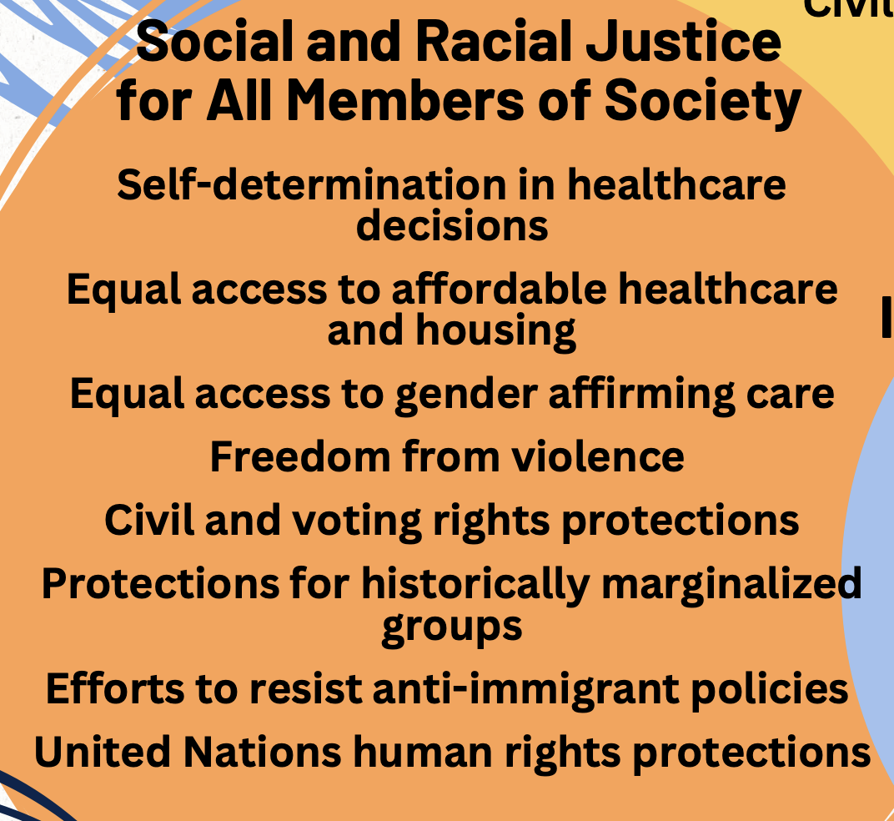
The 3 Priority Bills and AAUW California PPPs
AB 1766 and AB 1845
The office of Assemblymember Maggy Krell invited AAUW California to co-sponsor this human trafficking bill package. As co-sponsors, we have had a meaningful role in shaping both measures.
The issue of human trafficking is now more urgent than ever, as traffickers increasingly use digital exploitation to target even younger children, including in early elementary and middle school.
These bills strongly align with our Public Policy priority of Social and Racial Justice - Freedom from violence in all its forms and wherever it occurs.
AB 1876
This bill is very similar to SB 418, one of our A priority bills in 2025 that made it to the Governor’s desk and was vetoed due to cost concerns because the bill included 12 months’ coverage for hormone therapy.
AB 1876 is virtually identical to SB 418, except hormone therapy coverage has been removed.
AB 1876 strongly aligns with our Public Policy priority of Social and Racial Justice - Self-determination in reproductive health, and Equal access to quality…health care including gender affirming care.
Click here to access PPPs
Notes:
MM

Slide 26
Talking Points for Assembly Bill 1766
Human Trafficking Prevention Education
Author: Assemblymember Maggy Krell
(AAUW California Sponsored)
AAUW California a cosponsor of AB 1766 by Assemblymember Maggy Krell.
Human trafficking and exploitation is a local, state, national and global crisis which impacts men, women and children of all ages. However, children are increasingly the target for sex and labor trafficking and online exploitation circles.
While traffickers often target vulnerable populations, no socioeconomic group or student demographic is immune to the threat of human traffickers.
Cases of child exploitation, including trafficking, are found in every area of the country—rural, suburban, and urban settings–and involve economically and demographically diverse groups of children spanning from early childhood through adolescence.
Current law requires age-appropriate education on human trafficking for students in grades 7 – 12; however we know that children younger than 12 are often vulnerable targets for human traffickers.
Recent research shows that the average age of exploitation is getting even younger for minors.
We also know that new forms of digital exploitation are often overlooked by educators.
Notes:
MM

Slide 27
Talking Points for Assembly Bill 1766 (cont’d)
When school professionals have appropriate training, schools are an institution well-positioned to identify, and report suspected trafficking and connect affected students to critical services.
As education at an early grade level with face-to-face instruction remains vital, schools are also uniquely positioned to be a critical source of information about what human trafficking is and how children can develop healthy relationships and identify and reject exploitation by adults.
AB 1766 would require the Instructional Quality Commission to consider the inclusion of developmentally appropriate human trafficking and exploitation lessons for grades K-12 on the following subject matter:
  How to prevent human trafficking, including online exploitation and intrafamilial exploitation risks.
  Help-seeking strategies, healthy boundaries, healthy relationships, and bodily autonomy.
  How to stay safe from sexually exploitative materials and online deepfakes.
  How to recognize and report concerning behaviors.
The bill also expands evidence-based training requirements for key staff to better identify human trafficking and exploitation signs and online risks, and to ensure proper interventions and reporting in suspected human trafficking and exploitation cases.
We respectfully ask for your “Yes” vote on AB 1766
Notes:
MM

Slide 28
Talking Points for Assembly Bill 1845
Student Safety and Anti-Exploitation Act
Author: Assemblymember Maggy Krell
(AAUW California Sponsored)
AAUW California a cosponsor of AB 1845 by Assemblymember Maggy Krell.
Human trafficking and exploitation is not usually associated with college campuses. However, a study conducted among college students on 12 Southern California campuses found that nearly 1 in 5 students experienced force/coercion into selling sex as a college student and 34% had considered selling sex to support loved ones and/or pay for school.
College students can be particularly vulnerable to risk factors such as housing instability, lack of social or familial support, or first-time encounters with exploitative situations.
This is compounded by increased risks of targeting based on histories of trauma or marginalization, based on factors like gender, sexuality, race, ethnicity, immigration status or socioeconomic class.
Notes:
MM

Slide 29
Talking Points for Assembly Bill 1845 (cont’d)
In 1972, Title IX was federally enacted to prohibit sex-based discrimination, like sexual harassment or sexual violence, in any education program receiving federal funds.
While human trafficking and sexual exploitation through online platforms, social networks, recruitment or coercive relationships constitute severe forms of gender-based violations under Title IX, existing law does not specifically require the inclusion of human trafficking in campus training and protocols.
To address human trafficking and exploitation on college campuses and remedy gaps in Title IX coverage, AB 1845 requires post-secondary institutions to:
Update their sexual harassment training for employees to include human trafficking and require employees to receive training annually.
Ensure campus officials include human trafficking related crimes when compiling records of crimes on campus.
Construct written agreements with law enforcement clarifying human trafficking investigation responsibilities.
Adopt a policy concerning incidents of human trafficking, a statement that trafficking is a state and federal crime and physical signs that may indicate trafficking is occurring.
We respectfully ask for your “Yes” vote on AB 1845
Notes:
MM

Slide 30
Talking Points for Assembly Bill 1876
Fair Care for All Act
Author: Assemblymember Dawn Addis
AAUW California is in strong support of AB 1876 by Assemblymember Dawn Addis.
Recent trends in the federal government challenging the legality of diversity, equity, and inclusivity have created uncertainty about the future of nondiscrimination protections in healthcare.
This bill would explicitly prohibit a health plan or a health insurance provider from denying coverage, benefits, or limiting healthcare services to a person based on their race, color, national origin, age, disability, or sex.
Sex, here, includes sex assigned at birth and sex characteristics such as intersex traits, pregnancy, and gender identity.
In preventing discrimination in healthcare coverage, AB 1876 would protect anyone who is subject to discrimination, generally, and sex stereotyping, specifically, from losing coverage, being denied benefits, or limiting healthcare services based on sex, regardless of shifts in federal interpretations of sex and nondiscrimination.
Notes:
MM- if they printed off these talking points before, they need to print off the new ones that were posted to the website as of Monday morning.

Slide 31
Talking Points for Assembly Bill 1876 (cont’d)
This bill will also specifically increase protections for transgender and gender diverse communities, providing necessary safeguards for these communities at a moment when they are facing increasingly steep barriers for accessing safe and affordable healthcare across the United States, and at a moment in which California and its providers are also being pressured to roll back inclusive and equitable healthcare access.
Passage of AB 1876 will strengthen protections against discrimination in healthcare coverage, benefits, and services in California in the face of federal shifts away from equity, inclusion, and nondiscrimination. .
It will also send a powerful message of support to the LGBTQ+ community, affirming that their needs matter. Creating an environment where all individuals can express their identities without fear is foundational to a strong democracy.
*A similar bill, SB 418, passed the Legislature in 2025 but was vetoed due to cost concerns. The provision that led to that veto has been removed from AB 1876.
We respectfully ask for your “Yes” vote on AB 1876
Notes:
MM

Slide 32
Republican Offices
Some offices, particularly Republican offices, may push back on AB 1876.
Get an idea how they will view AB 1876 by checking their voting record on the very similar SB 418 in 2025: Floor Votes – 2025 A Priority Bills SB 418 and SB 771
Represent AAUW CA views confidently and respectfully. Public discourse is intended to include differing views.
In response to questions on our position on a bill, refer to our PPP’s that support Social and Racial Justice, Equal Access to Quality Education, Economic Security for All Women and Girls, and Women in Leadership. These values underlie the position we take on legislation.
We support AB 1876 because we believe in self-determination in reproductive health, and this bill will strengthen protections for bodily autonomy in gender-based healthcare.
If you are asked a question and don’t know the answer, it is fair to say so and advise that we will follow up with the member to get them the answer.
It is always fair to suggest that “we may need to agree to disagree” on the bill.
Notes:
KVO

Slide 33
Strategic Storytelling
If you have a personal experience related to a bill that you can share, this can be powerful and compelling. You should share the story if you can do so in 3 sentences or less.
Sentence 1: Introduction / Problem
Sentence 2: Brief Elaboration
Sentence 3: Connection to Bill / Why it matters
Example:
My sister-in-law is transitioning and I have watched her anxiety rise as trans healthcare has been attacked federally. She worries that her insurance company will start denying necessary medical care, calling it “cosmetic.” AB 1876 will help people like my sister-in-law by providing necessary healthcare access in California, regardless of federal interpretations of nondiscrimination policy.
Notes:
Centering if time

Slide 34
Questions

Slide 35
Team Leaders Checklist
Team Leaders, thank you so much for stepping into this important role - we truly appreciate your leadership and commitment.
Please refer to the Team Leader Checklist for a clear overview of the key tasks and responsibilities you will be managing.
Notes:
Amy

Slide 36
Team Leaders Checklist
Schedule a dry run
☐ Set a time for the team to practice the together
☐ During the dry run, time the presentations to ensure that all of the materials can be covered in the allotted time. Remarks should be brief. Most meetings will be only 15-20 minutes.
During the meeting
☐ Lead introductions and AAUW overview using the Team Leader Script.
☐ Guide member presentations of AAUW branch activities
☐ Thank the legislator for their leadership, their support of AAUW priorities, their Yes vote in 2025 on SB 418 and SB 771, and their authorship of AAUW priority legislation, as applicable.
☐ Guide member presentations of priority bills, for which they should use the Bill Script and the bill talking points: AB 1766 Bill Talking Points, AB 1845 Bill Talking Points, and AB 1876 Bill Talking Points.
☐ Take notes using the Visit Note Taking Form
☐ Deliver closing thanks using Meeting Script – Closing and ask for a photo.
After the meeting
☐ Send a thank you note using the Thank You Letter Template
☐ Complete the Lobby Days Visit Report
☐ Upload your Lobby Day photo here: https://airtable.com/appvx5LcAVIMMZuy8/pagOrY5IILGUp7mCU/form.
Share meeting details with the team
☐ Day and time
☐ Location or Zoom link
☐ Legislator name
☐ Name and title of the person you will be meeting with
Assign roles
☐ Decide who will present each bill, and who will speak about their branch activities
Research the legislator
☐ Determine whether the legislator is aligned with AAUW’s values
☐ Check HERE to see how they voted on SB 418 and SB 771 in 2025
☐ Note if they authored one of our recent priority bills -SB 771 (Stern), SB418 (Menjivar), AB 1766 (Krell), AB 1845 (Krell), AB 1876 (Addis)
☐ Check HERE to see whether they serve on the committees that will hear the three priority bills
Notes:
Amy

Slide 37
Lobby Days Materials
The materials we shared tonight are posted on the AAUW California website: Lobby Days 2026 - Advocate for Bills to Advance AAUW Values - AAUW California
Notes:
Amy

Slide 38
Questions

Slide 39
We have a post-webinar survey that will launch when you exit the meeting. Please take a minute to complete it. Your feedback helps us to improve our presentations and understand what helps you the most.
Thank you for your time.

