Slide 1



This meeting will be recorded
The recording and this PDF will be posted on the AAUW Peer Group Webpage
Please mute your Speaker during the presentation
Questions will be addressed at the end of the meeting
Please use the Chat to “everyone” for questions
Please unmute when asking a question

Slide 2
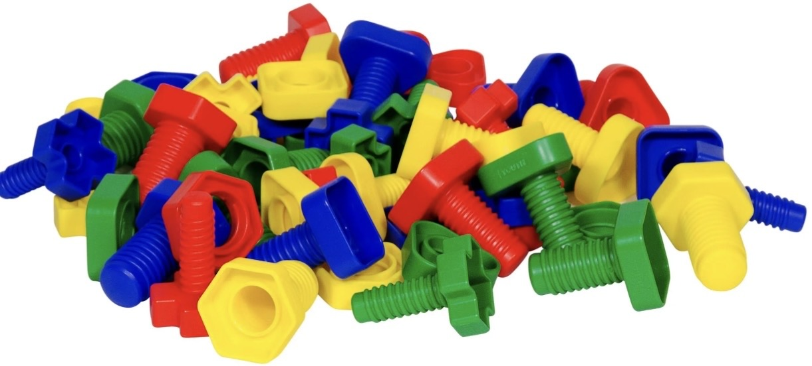
AAUW CA Fund Peer Group
September 30, 2025
The Nuts and Bolts of
The AAUW Fund

Slide 3
AAUW CA Fund Committee
Chair: Deanna Arthur, AAUW CA Director, Alhambra-San Gabriel,
email: aauwfund@aauw-ca.org
Committee Members:
Tobi Balma, Long Beach, La Palma-Cerritos, Greater Whittier, CA Online
email: aauw.tobi@gmail.com
Cheryl Plotkin, Alhambra-San Gabriel
email: caplotkin62@gmail.com
Mary Jane Sanchez-Fulton, Coachella Valley
email: mjsanchezfulton@gmail.com

Slide 4
What We Will Cover
What is the AAUW Fund?
Your Responsibilities
Unrestricted Funds
Restricted Funds
Ways to Contribute
5 Star Program
Requesting a Fellow
Fund Donation Form
Fellowships and Grants
Resources
Questions

Slide 5
What is the AAUW Fund?
It is the umbrella that supports all of AAUW’s programs and initiatives
It is the part of AAUW that helps keep AAUW running to be able to fulfill its Mission and Vision.
It includes Fellowships and Grants, and much, much more.
The AAUW Fund remains the largest source of funding exclusively for graduate women.
AAUW CA members and branches generously donated $475,275 to AAUW Fund in 2024.
Contributions to the AAUW Fund are tax deductible.

Slide 6
Your Responsibilities to Your Branch
● Be knowledgeable of the AAUW national fundraising policies and ensure the branch complies with AAUW national policies and IRS regulations.
● Be knowledgeable about AAUW programs to promote fundraising efforts to meet goals.
Honor donor intent and inspire members to underwrite AAUW and its programs through AAUW Greatest Needs Fund (9110), Education and Training Fund (4450), Economic Security Fund (4449) and Leadership Fund (4452).

Slide 7
Your Responsibilities to Your Branch
Ensure member donations are submitted in a timely manner.
● Work with other branch officers and committees to integrate fundraising with other priorities
Participate in AAUW fundraising training such as webinar/workshops or opportunities provided by others.
● Celebrate successful fundraising and its impact by thanking and recognizing donors through branch publications, at branch meetings and personal thank-you notes..
● Review AAUW Monthly branch donation reports and report any discrepancies to the state AAUW Fund Chair.

Slide 8
Your Responsibilities to AAUW National
Be familiar with and adhere to all AAUW fundraising policies, AAUW Bylaws, and IRS regulations.
Help members understand the vital relationship between AAUW programs and donor funding.
Dialogue with AAUW about concerns or questions raised related to fundraising efforts or disbursement.
Submit donations in a timely manner via AAUW Contribution Report Form.
Share successful fundraising ideas.
Lead by example, be an AAUW donor.

Slide 9
Your Responsibilities to AAUW CA
Celebrate successful fundraising and its impact.
Share successful fundraising ideas.

Slide 10
Restricted vs Unrestricted Funds
Restricted:
can only be used for the specific fund purpose
Vs
Unrestricted Funds:
are used wherever there is a need

Slide 11
Unrestricted Donations
The Greatest Needs Fund #9110
🌟 Provides flexible, unrestricted support for AAUW’s mission of advancing equity for women and girls through research, education, and advocacy.
🛠️ Donations are used where they’re most needed, including:
Research – producing reports on gender equity, pay gaps, workplace issues. grants and career development.
Advocacy – lobbying and grassroots efforts for gender equity laws and policies.
Leadership & Economic Security – programs like salary negotiation
workshops and leadership training.
💡 Allows AAUW to respond quickly to emerging issues, and some critical operations like administrative costs.
Ensure financial stability and innovation.
Keep core programs sustainable over time.

Slide 12
Preferred Restricted Funds
4513 — The Defend Higher Education Fund will enable AAUW to elevate the critical higher education issues impacting women, mobilize advocates across the country, provide strategic resources to students, staff and faculty on campus, and fuel investments in the infrastructure and technology necessary to move our mission forward.

Slide 13
Preferred Restricted Funds
4514 - Public Policy General
The Public Policy Fund is focused on increasing the impact of our Action Network through growing the number of advocates across the country and providing timely, accurate, and actionable information about our key issues. This fund helps equip branches across the country with timely, customized talking points on core policy issues like Title IX, student debt, and pay equity. Support to this fund enables AAUW to reach and energize new advocates—strengthening our collective impact in the fight for gender equity in education and the workplace.

Slide 14
Popular Restricted Fund
#3999 Legal Advocacy Fund
Applications Open August 1 Application Deadline September 30
Funds cases in state or federal court that address sex discrimination in employment or education and have the potential to set or reinforce precedent for future cases on gender discrimination. (Pay Inequity, Violations of Title IX, Title VII of the Civil Rights Act of 1964, & Tenure Violations)
Provides renewable grants ($5K-$20K)
Provides Clinic Grant Awards to Law Schools
.

Slide 15
Ways to Contribute
1. Use the Donate Link on the AAUW Webpage
2. Fundraise through your branch
3. Become a Champion ($5000 donation)
4. Leave a Legacy (Legacy Circle)
5. Donate stocks
6. Give through your IRA (Qualified Charitable Donation)
7. Make a grant from your Donor Advised Fund
8. Donate cryptocurrency
9. Contact the AAUW National Office for Funds not listed on the AAUW Donate Page (for a link or to mail a check)

Slide 16

Raise $30 per member in FY26 towards the Greatest Needs Fund
Increase contributions to the Greatest Needs Fund by 15% from the last fiscal year
Increase the number of individual donors compared to the previous fiscal year
Make a branch contribution to the Defend Higher Education (#4513 or Public Policy Funds (4514)
Recruit at least one Legacy Circle member from your branch in FY26

Slide 17
Fellowships and Grants https://www.aauw.org/resources/programs/fellowships-grants/
Applications Open August 1 Application Deadline September 30
For Individuals
American Dissertation Fellowship ($25,000)
American Short-Term Research Publication Grant ($8,000)
American Postdoctoral Research Leave Fellowship ($50,000)
Career Development Grant ($8,000)
International Fellowship (Master’s and Doctorate Degrees) ($20-$25,000)
International Project Grant (15,000)
International Postdoctoral Research Fellowship ($50,000)
Selected Professions Fellowship ($20,000)
For Organizations
AAUW Branch and State Affiliate Community Action Grants (up to $10K)
Community Action Grant (up to $75K)

Slide 18
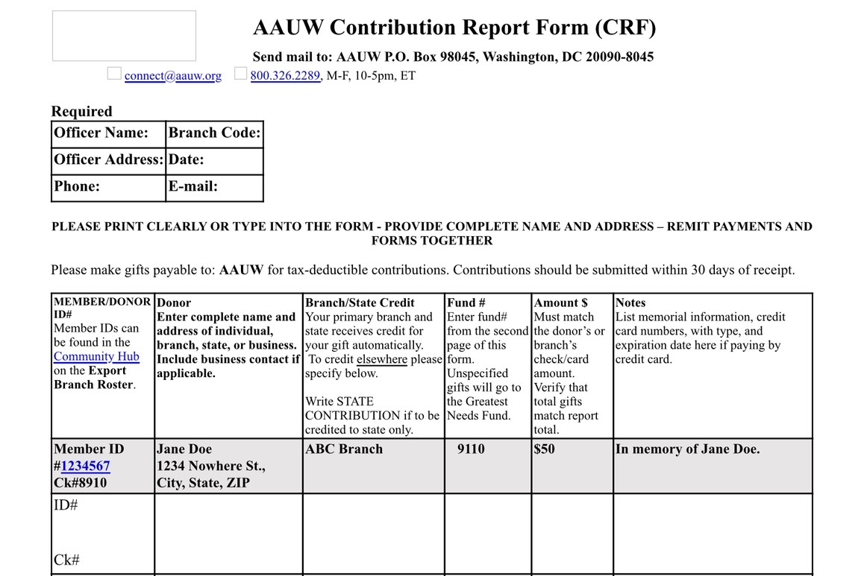
AAUW Fund Contribution Instructions and Form https://www.aauw.org/resources/member/contribution-report-form/

Slide 19
Request an AAUW Fund Speaker https://www.aauw-ca.org/request-aauw-fund-speaker/
Instructions are on the AAUW-CA Website
You must work with our AAUW California Scheduler by submitting a request using this link: https://docs.google.com/forms/d/e/1FAIpQLSeCG_qfu91lMTv2kSrpMrJszmCdq9n3lMWDtJMqmAoPSFdQZQ/viewform
Current fellows are heavily involved in their studies and very busy.
The schedulers generally require four to six weeks of advance notice to schedule a speaker.
The schedulers contact current fellows, but on occasion may call on past fellows who are often more readily available, and can also speak to the longer-term impact an award has had on their lives.
We suggest that you prepare a backup program should a fellow not be available on the dates you request.
Branches are limited to one visit from a current fellow every other year.

Slide 20
Resources
5 Star Program
AAUW CA Fund Webpage
AAUW CA Fundraising Guidelines
AAUW CA Peer Group Webpage
AAUW CA Request a Speaker Link
AAUW Fund Donation Form
AAUW Fund Donation Webpage
AAUW Legal Advocacy Fund
AAUW National Fellowships and Grants
Branch Job Description
Current and Past LAF Cases
Fellowship Directory 2004-5 thru 2023
(by name of recipient)
Fellowship Directory 2023 to present
Greatest Needs Flyer
Legacy Circle (CA Webpage)
Legacy Circle Brochure
Named Gift Honoree Info
National AAUW Fundraising Policies
Planned Giving
For Information About the Recipients of Your Branch Endowment/Grant:
contact awards@aauw.org or
AAUW CA President Charmen Goehring at statepresident@aauw-ca.org

Slide 21
Questions

Slide 22
Next Steps
Future Topics of Interest?
Save the Dates!
Register on the AAUW CA Calendar for
Upcoming AAUW Fund Peer Group Meetings
October 28, 2025; November 18, 2025;
March 10, 2026, and April 28, 2026.
These meetings will also be held on Tuesdays at 7 pm.

Slide 23
Thank You!

