Slide 1


Membership, Planning, Branch Documents and Structure, and more
April 3, 2025
Notes:
Record!

Slide 2
agenda
Welcome and Introductions – Kathy Ford
Poll Questions – Kathy Ford
Membership and HUB – Carol McMillan
Planning, Budgeting and Year-End Reporting – Indrani Chatterjee
Missing Documents, Registry Search Tool and Restoring Charitable Status – Kathy Ford
Combining Branches and Branch Dissolution – Sharyn Siebert
Q&A

Slide 3
Poll Questions
How many members in your branch?
What is the status of your branch membership?
Does your branch have a formal budgeting process?
Does your branch maintain a permanent file that includes all founding documents, contracts, other important documents and regulatory filings for the past 7 years?

Slide 4
Membership Questions
New National Dues - $74 beginning April 1, 2025
Student Dues – Still $18.81
Lifetime - $1480 (20 times current annual National dues)
All national dues are fully Tax-Deductible
If approved by the membership, State dues will be increased to $30 for the new fiscal year, beginning July 1, 2025. Payments received starting May 15, 2025 will be at the new rate for the new fiscal year.

Slide 5
Are Your Branch Dues Changing?
Should have been submitted by April 1
If you need to update yours, contact ASAP
  connect@aauw.org
  coopera@aauw.org

Slide 6
Special Membership Categories
Dual Members (multiple branches/states) – Members must use HUB themselves or write checks to dual branches
Paid Life members – State and Branch Dues apply
Honorary Life Members – 50 years of continuous membership – no national or state dues
  For those newly joining this category, (joined in 1975 or earlier), request certificate via connect@aauw.org

Slide 7
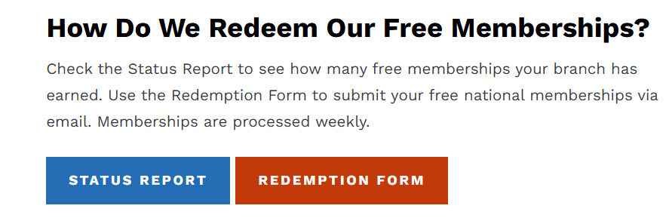

Shape the Future
Shape the Future – New members who join at an event – pay 50% of national dues – now $37 – Use Coupon Code STFF26
Note – For every two Shape the Future members, the branch earns a free national membership.
All but a few Branches have 1 or more free memberships. Must be used before end of June

Slide 8
Student Members
Free national membership for students of AAUW affiliate colleges/university. State Dues are $10
Coupon Codes - Student Associates (undergraduates) CUStudentFY26 and Graduate Students CUGradStudentFY26
Students not at affiliate colleges/universities – national dues still $18.81and state dues are $10

Slide 9
RECOMMEND RENEWING THROUGH HUB
Reminder email sent by National on the 20th of each month
  First reminder – 1 month prior to expiration
  Second reminder – month of expiration
  Third reminder – 1 months after expiration
  Fourth reminder – month grace period ends
Status as shown on Roster
  Current – within 12 months of join/start date
  Grace - within 90 days after the expiration date
  Future – Renewed ahead of join/start date

Slide 10
If members pay Branch by Check
Branch managers can renew members on HUB as well as add donations to AAUW Greatest Needs Fund
  Go to Renewals and Donations and click on pencil icon in the Renew column, click the box for each member being renewed
  For donations to Greatest Needs Fund, click pencil icon in Donation Amount Column
After all selections are complete, download and review Renewals and Donations Worksheet
If correct, click Pay Now
Do not process if incorrect. Send email to connect@aauw.org

Slide 11
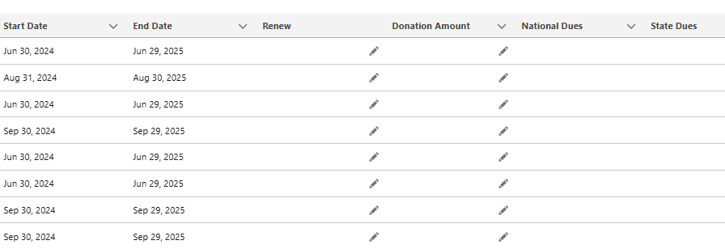
Sample of Branch Roster

Slide 12
Donations to other AAUW Funds
Members wishing to contribute to other National Funds Should do so through the Branch AAUW Fund Chair, or by mailing a check directly to National.

Slide 13
Planning-budgeting
& year-end reporting

Slide 14
PLANNING & BUDGETING
Budget Planning:
Before preparing a budget for Fiscal Year 2025-2026, conduct a thorough review of the branch’s financial position, strategic goals, and past performances to ensure the budget aligns with mission and resource allocation.
Review two years Revenues and Expenses - Current Fiscal Year and previous Fiscal Year
Simplify Strategic Goals - Ensure the budget aligns with the branch’s strategic plan and program goals

Slide 15
PLANNING & BUDGETING
Determine timeline - Set a target date for board approval and allow sufficient time for each step, including review and discussion
Agree on budget approach - Discuss and agree on the budget approach, including the level of detail, assumptions, and how much uncertainty can be included
Forecast future income and expenses - Estimate future income based on current fundraising and revenue activities, as well as potential new activities
Identify variable expenses - Consider variable expenses that may fluctuate throughout the year and plan accordingly

Slide 16
PLANNING & BUDGETING
Set fundraising targets - Establish clear and achievable fundraising targets that align with AAUW mission and Branch’s project needs
Budgeting:
Develop a Draft Budget and Review - Determine the costs required to achieve program goals and organizational objectives (such as: Increase membership). Project income based on current fundraising and revenue activities, as well as potential new activities.
Review the draft budget - Verify that the draft budget meets program and organizational goals, and review all assumptions

Slide 17
PLANNING & BUDGETING
Make adjustments - Make adjustments to the budget based on goals, capacity, and the need to match income and expenses
Present the budget to Board - Present the draft budget to Board for review and feedback
Obtain board approval - Present the final budget to the board for approval
Next Slide has a Sample Budget Worksheet

Slide 19
Year-end reporting
Year-end financial closing is the process of finalizing branch’s financial statements for the current fiscal year, ensuring accuracy and compliance, and preparing for the next year's financial planning.
Why it's important:
Accuracy and Compliance: Ensures the accuracy of financial reporting and compliance with accounting standards and regulations
Financial Health: Provides a clear picture of the branch’s financial performance and position, allowing for better decision-making

Slide 20
Year-End Reporting
Tax Reporting: Facilitates accurate tax reporting and compliance with tax obligations.
Internal Revenue Service (IRS): Form 990 or 990-EZ or 990 N
California State: Form 199 or 199N (if revenue is $50K or less), RRF-1,
CT-TR-1 and CT-NRP-2
Future Planning: Provides a solid foundation for future financial planning and budgeting.

Slide 23
Missing Documents
Tax exempt organization – search for a copy of the branch IRS Determination Letter or copies of past 990 series or Postcard 990-N:
  https://www.irs.gov/charities-non-profits/tax-exempt-organization-search
How can I find my branch entity number?
  https://www.ftb.ca.gov/help/business/entity-status-letter.asp
How can I find if my branch is incorporated?
  https://rct.doj.ca.gov/Verification/Web/Search.aspx?facility=Y
How can I find my branch affiliation formation documents?
  Contact Angela Cooper at National - coopera@aauw.org

Slide 24
Determination Letters, 990 series & 990-n (e-postcard)
Tax Exempt Organization Search Tool @ https://www.irs.gov/charities-non-profits/tax-exempt-organization-search
You can check an organization's eligibility to receive tax-deductible charitable contributions (Pub 78 Data). You can also search for information about an organization's tax-exempt status and filings:
Form 990 Series Returns
Form 990-N (e-Postcard)
Pub. 78 Data
Automatic Revocation of Exemption List
Determination Letters

Slide 25
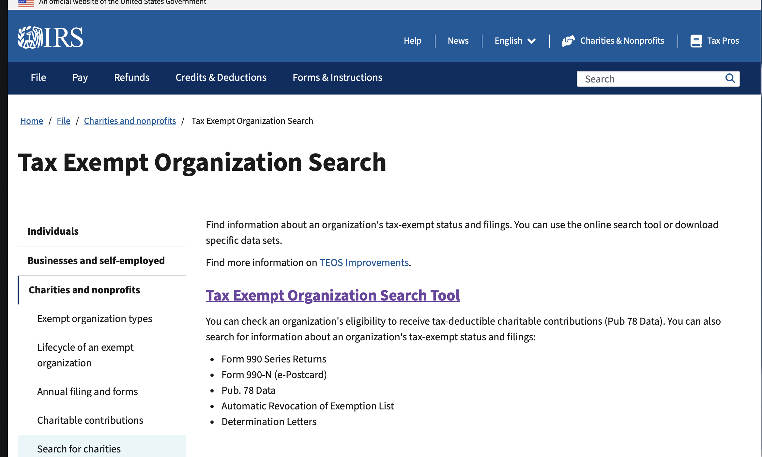
IRS Tax Exempt organization search tool - Step One

Slide 26
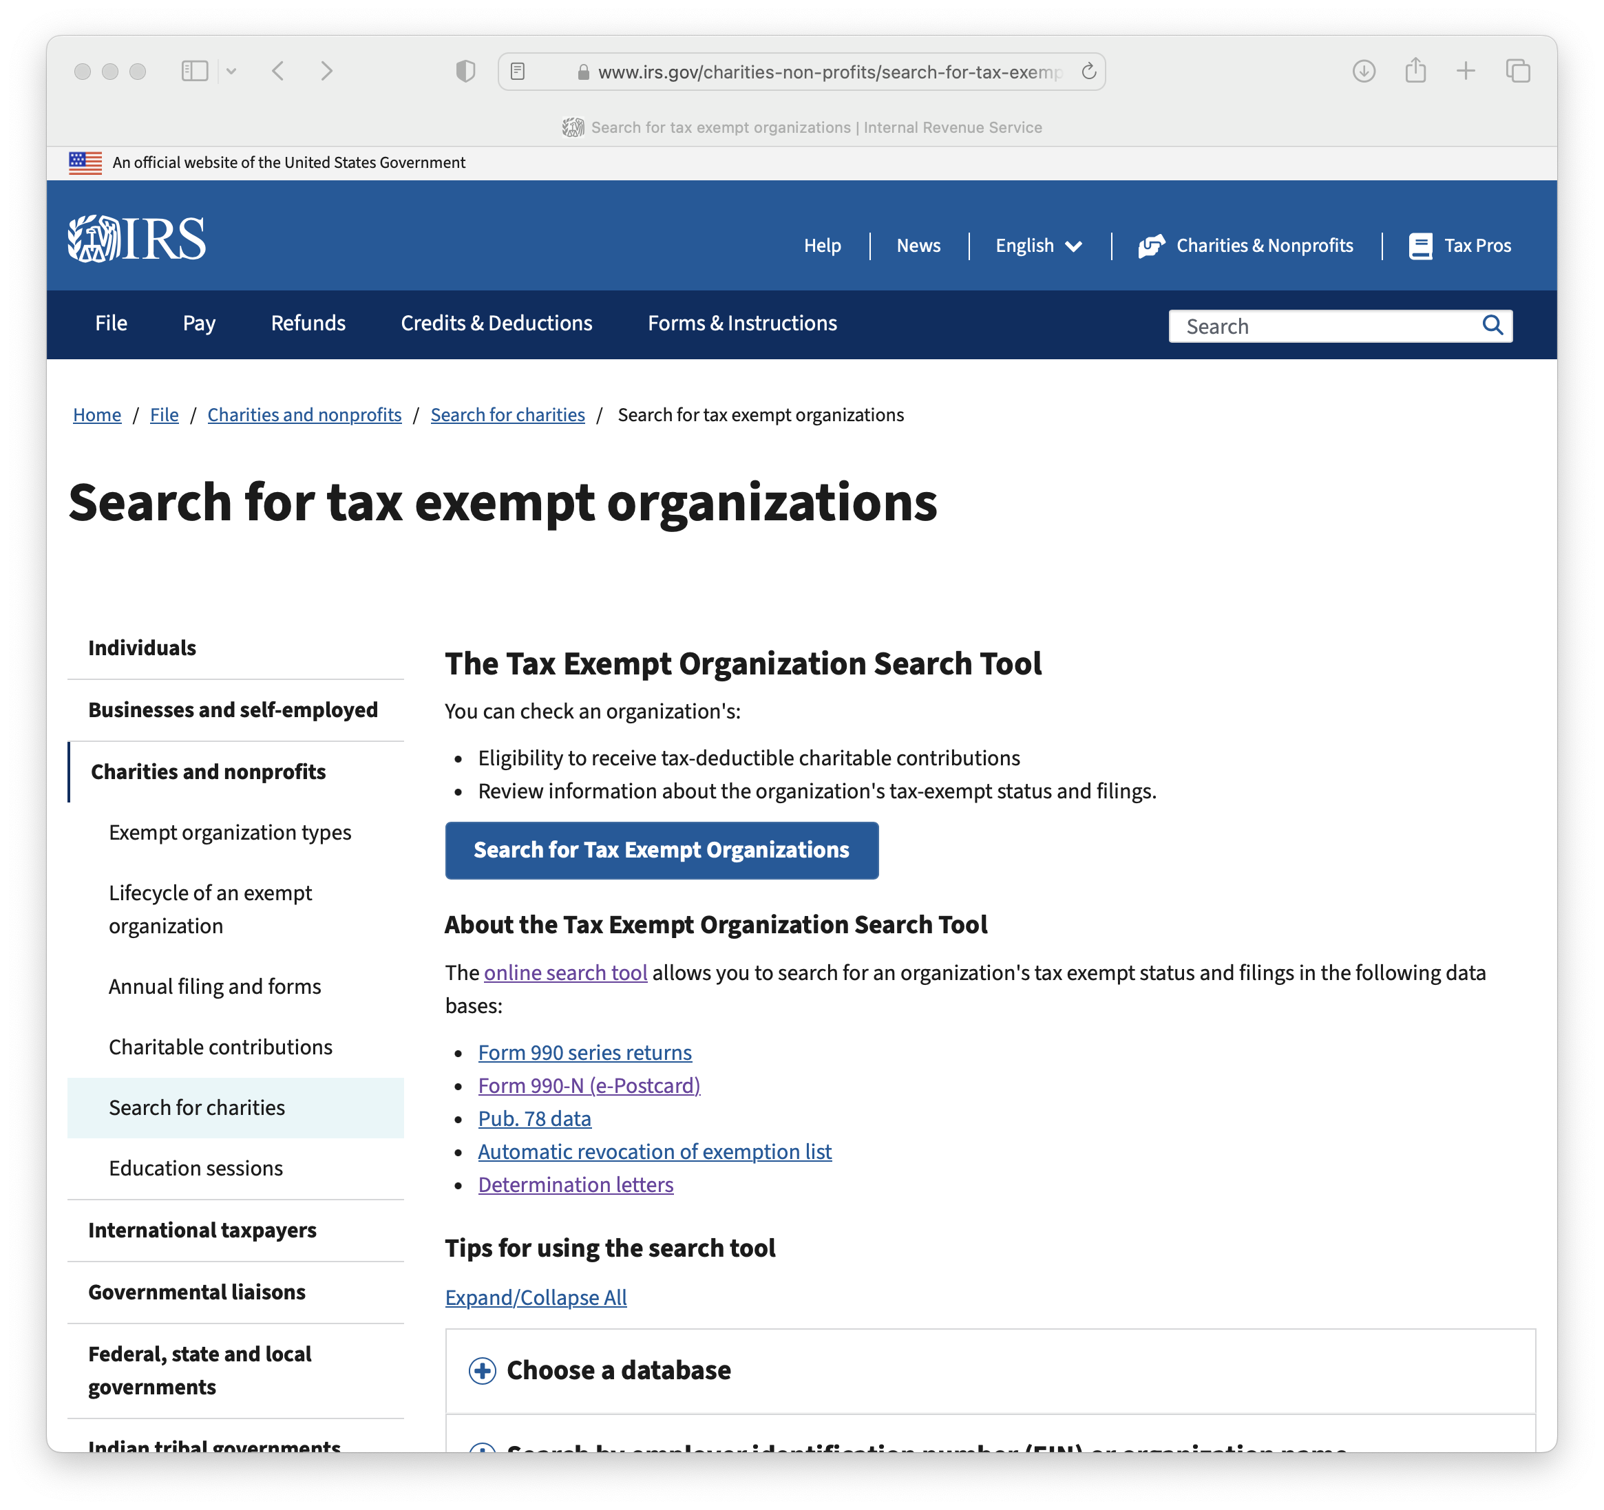
IRS Tax Exempt organization search tool – Step Two

Slide 27
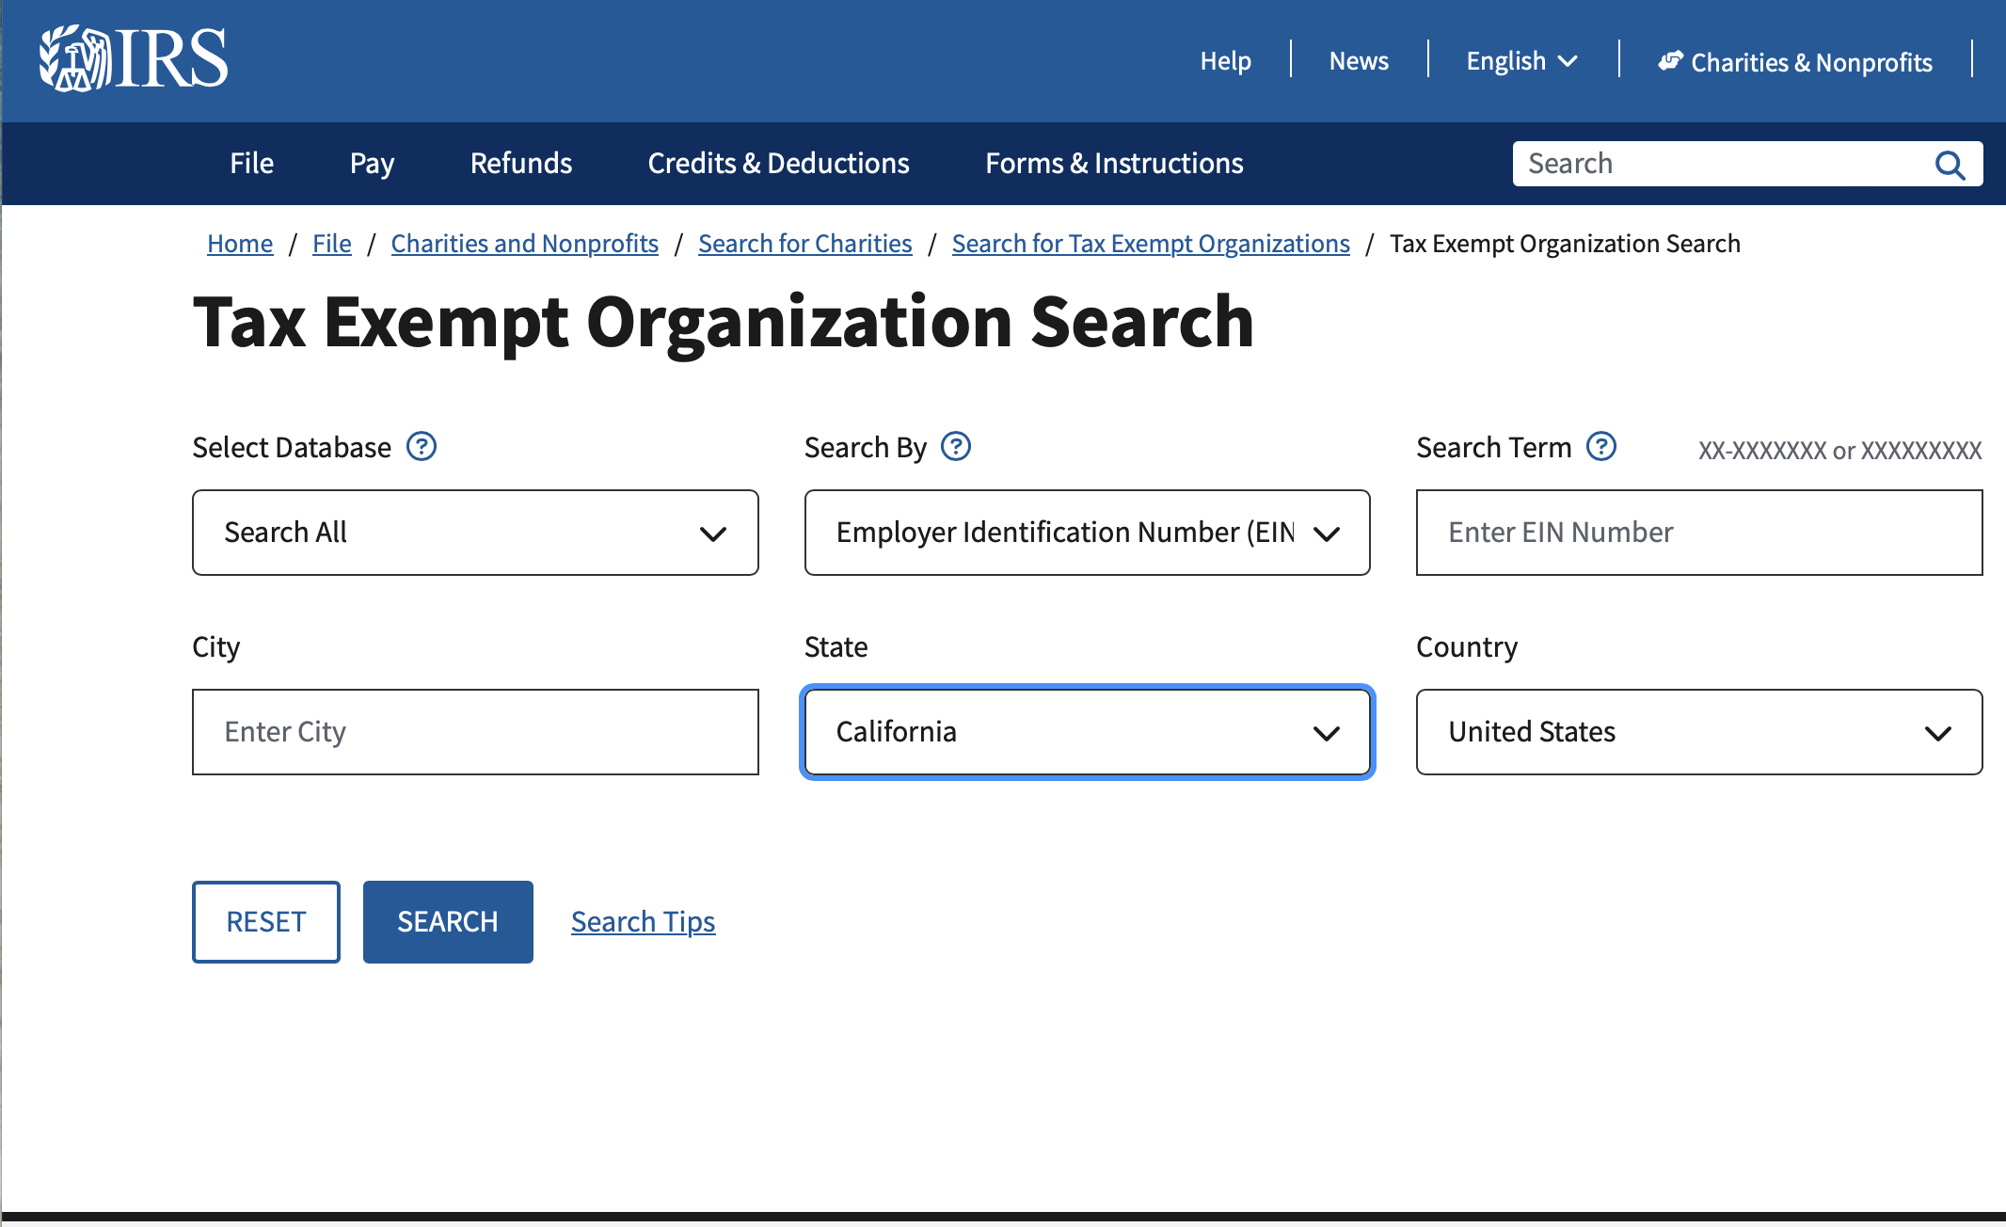
IRS Tax Exempt organization search tool – step three

Slide 28
Branch Entity number
Get an Entity Status Letter online at: https://www.ftb.ca.gov/help/business/entity-status-letter.asp
Input the name of your branch.
When the results are displayed, the entity number will be listed

Slide 29
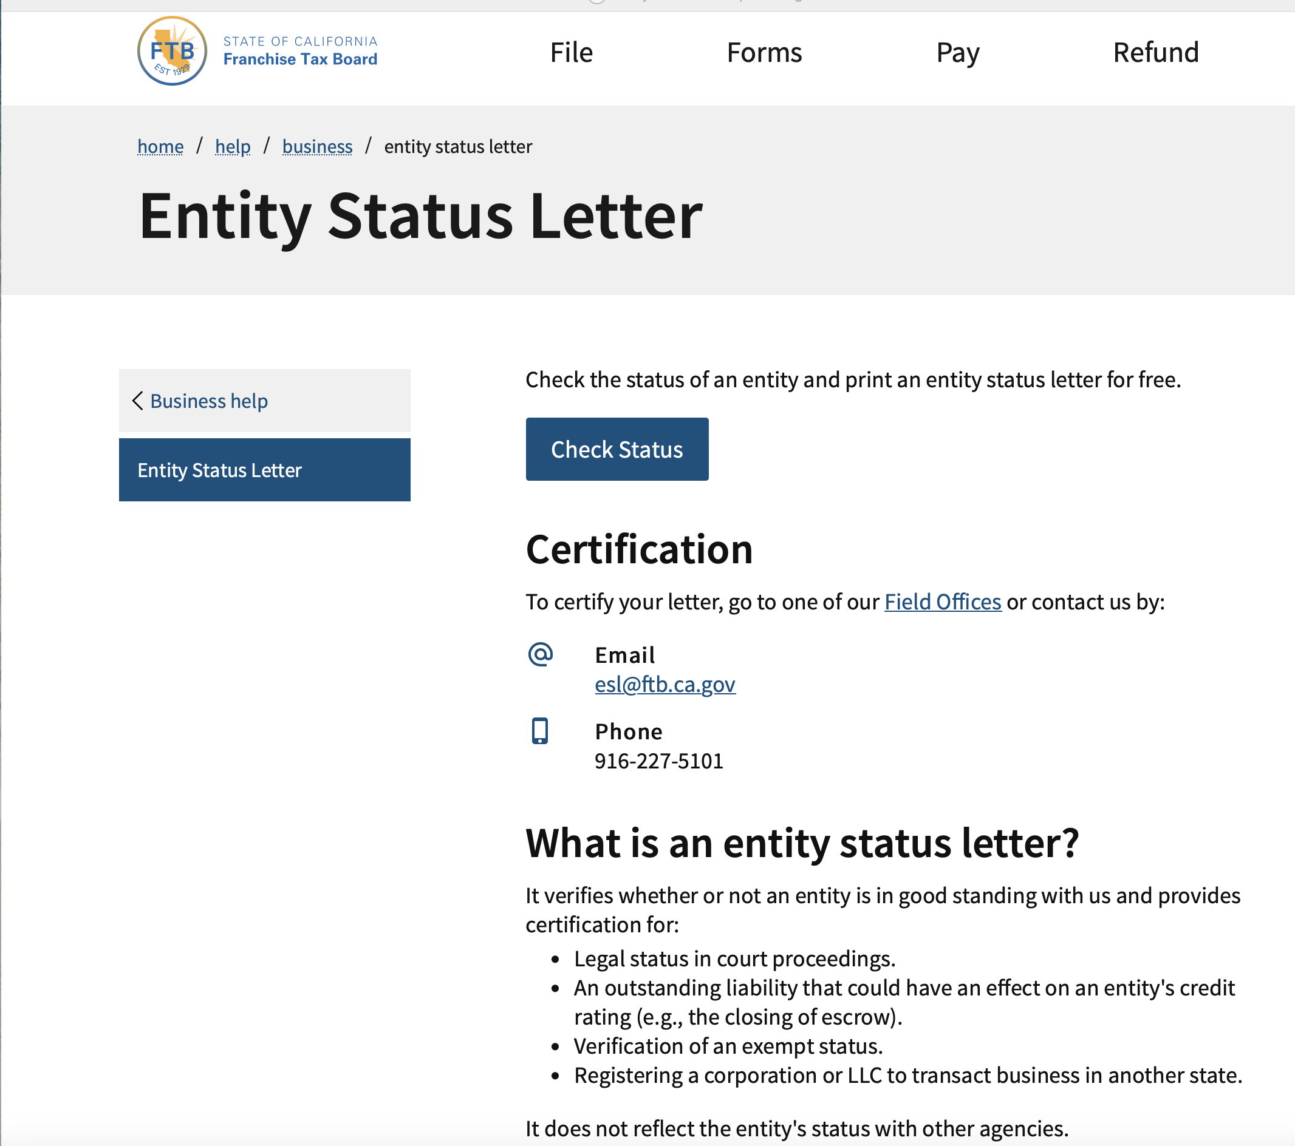
Get an entity status letter – step one

Slide 30
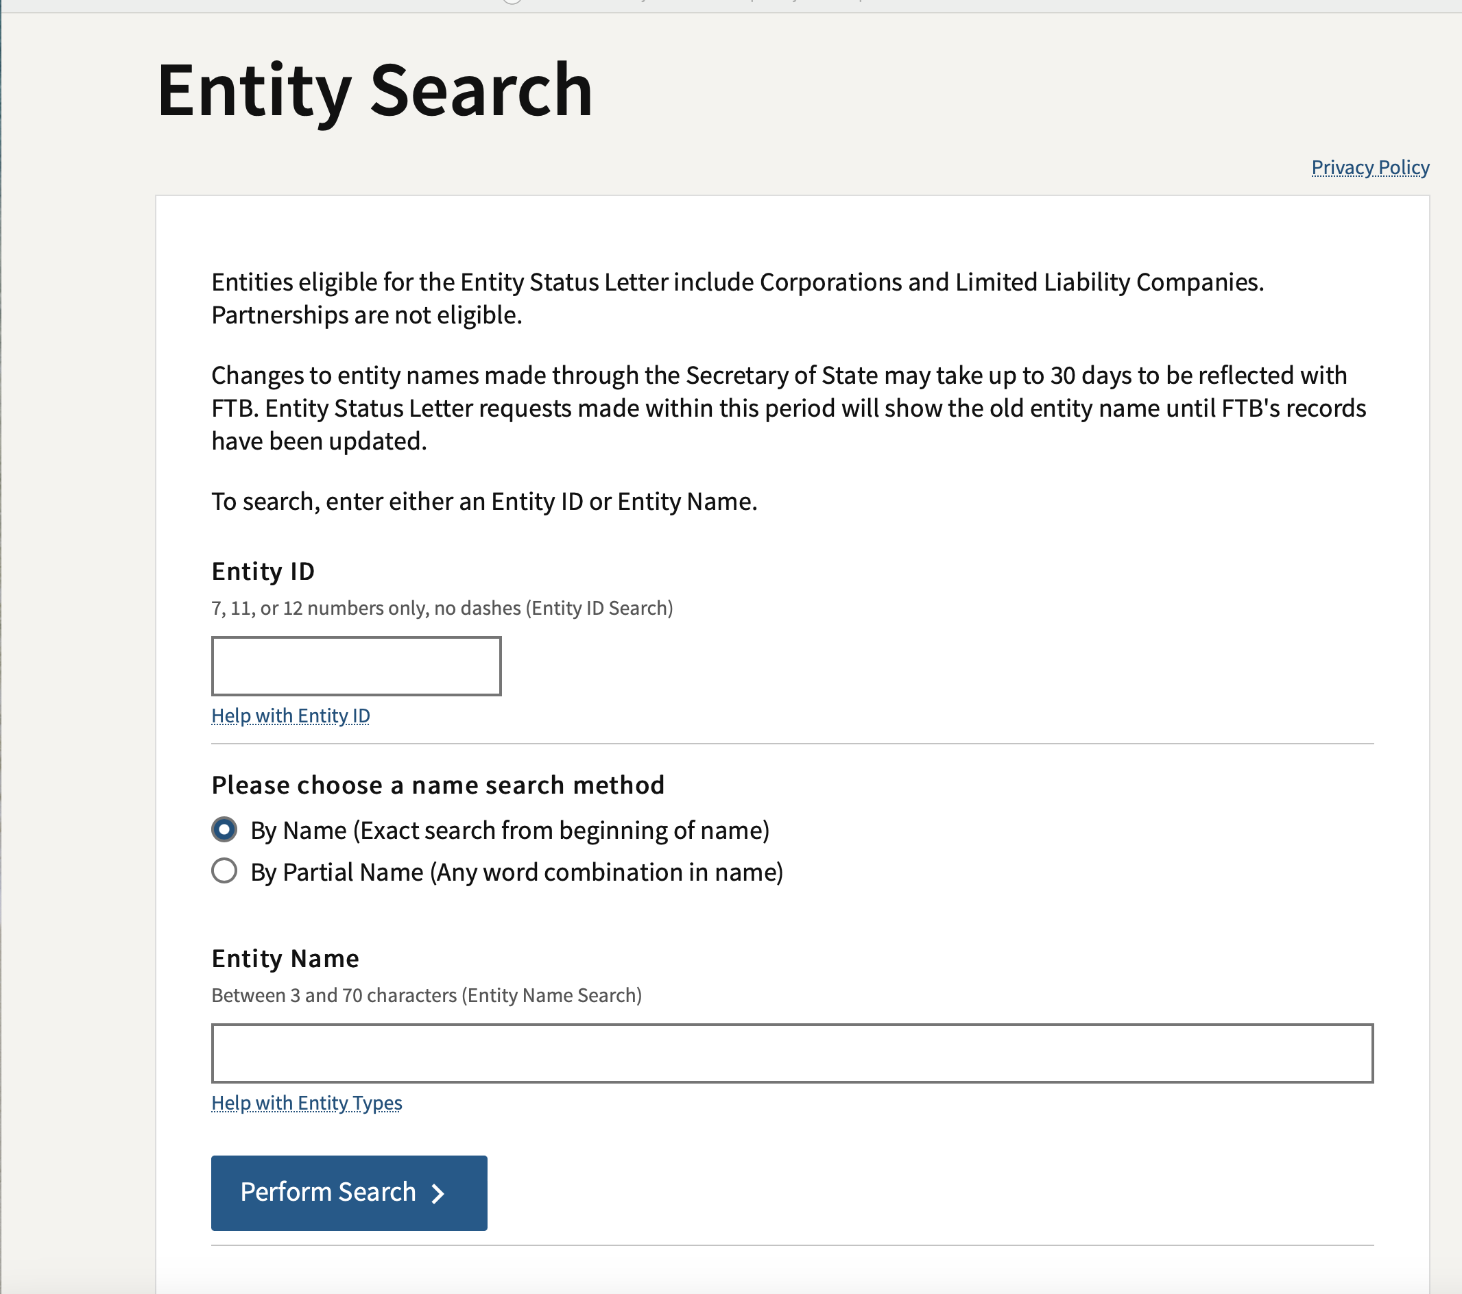
Get an entity status letter – step two

Slide 31
Is your branch incorporated?
Your branch name should include Inc.
You can also check the Registry Search Tool in the Department of Charities database @ https://rct.doj.ca.gov/Verification/Web/Search.aspx?facility=Y
Enter the branch Charity Registration number, FEIN or Corporate/organization number– but only one. Select “Charity” for program type. Enter the County, City, State and Zip code. This will narrow down the search.
Results will display your branch name – click on it and a detailed report will be displayed with links to various state filings.
The Entity Type (Corporate Class) will be displayed near the top,

Slide 32
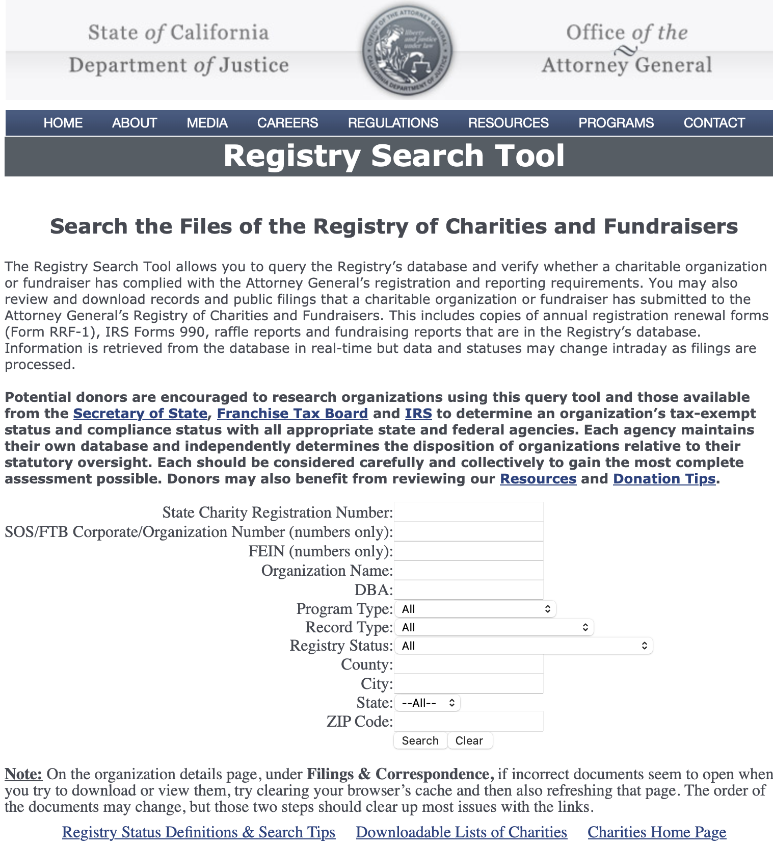
Registry Search Tool – one

Slide 33
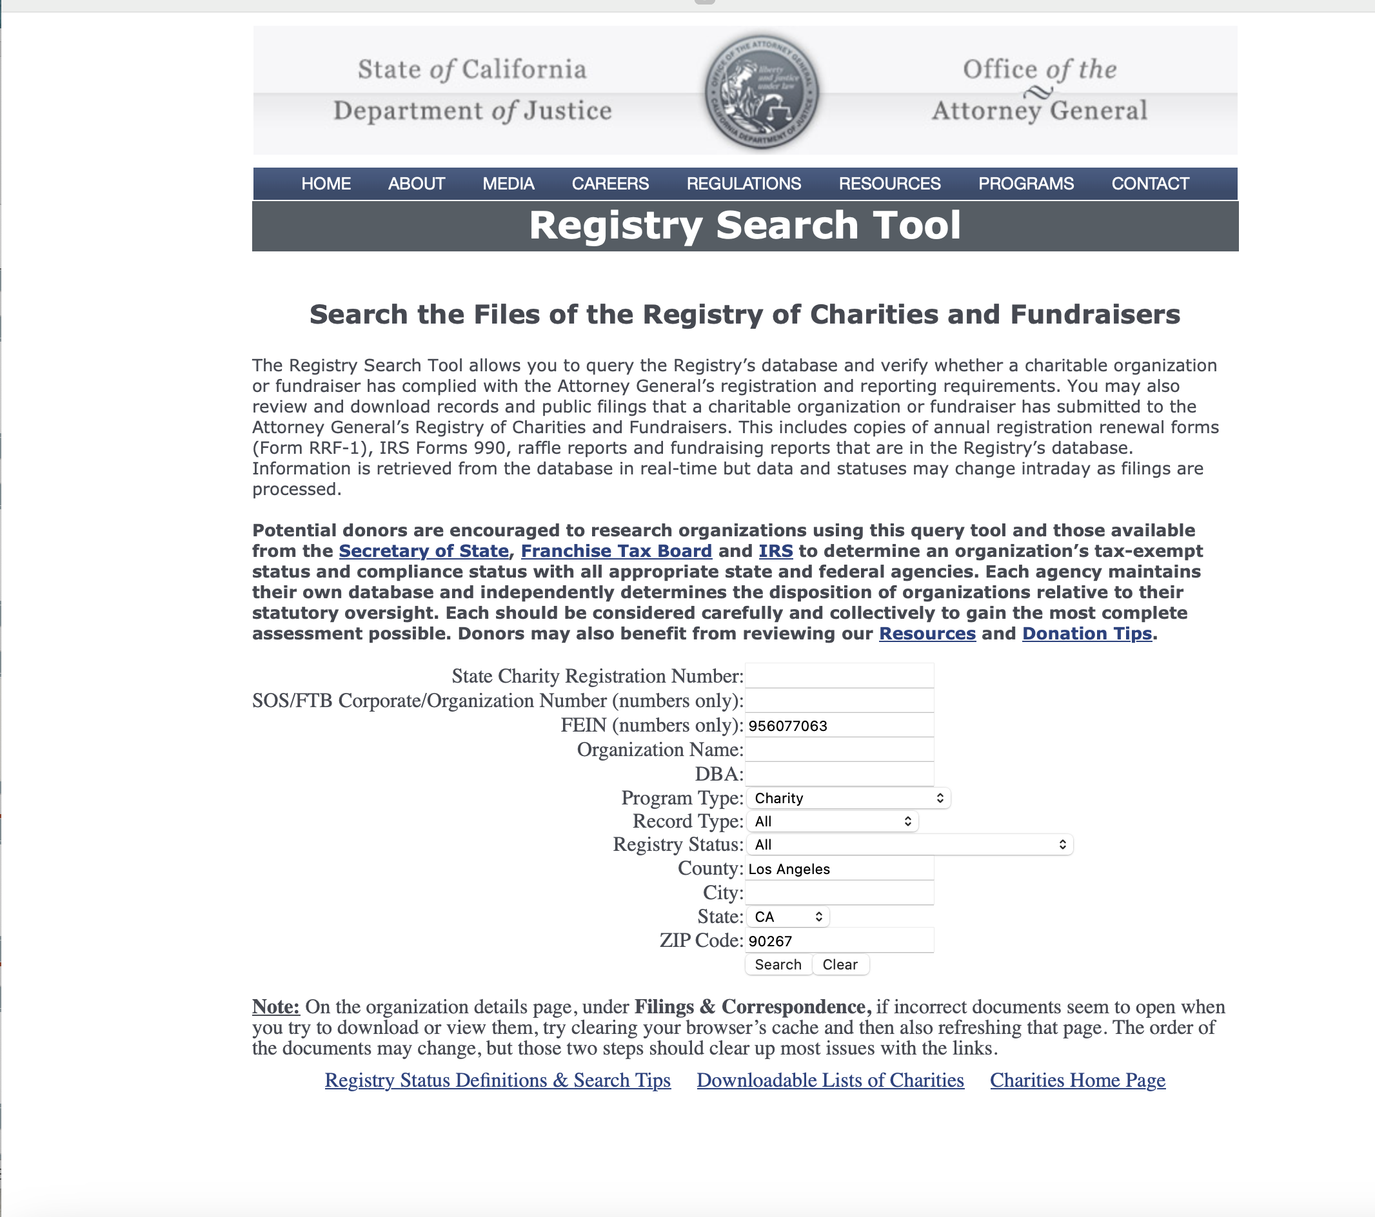
Registry Search Tool - two

Slide 34
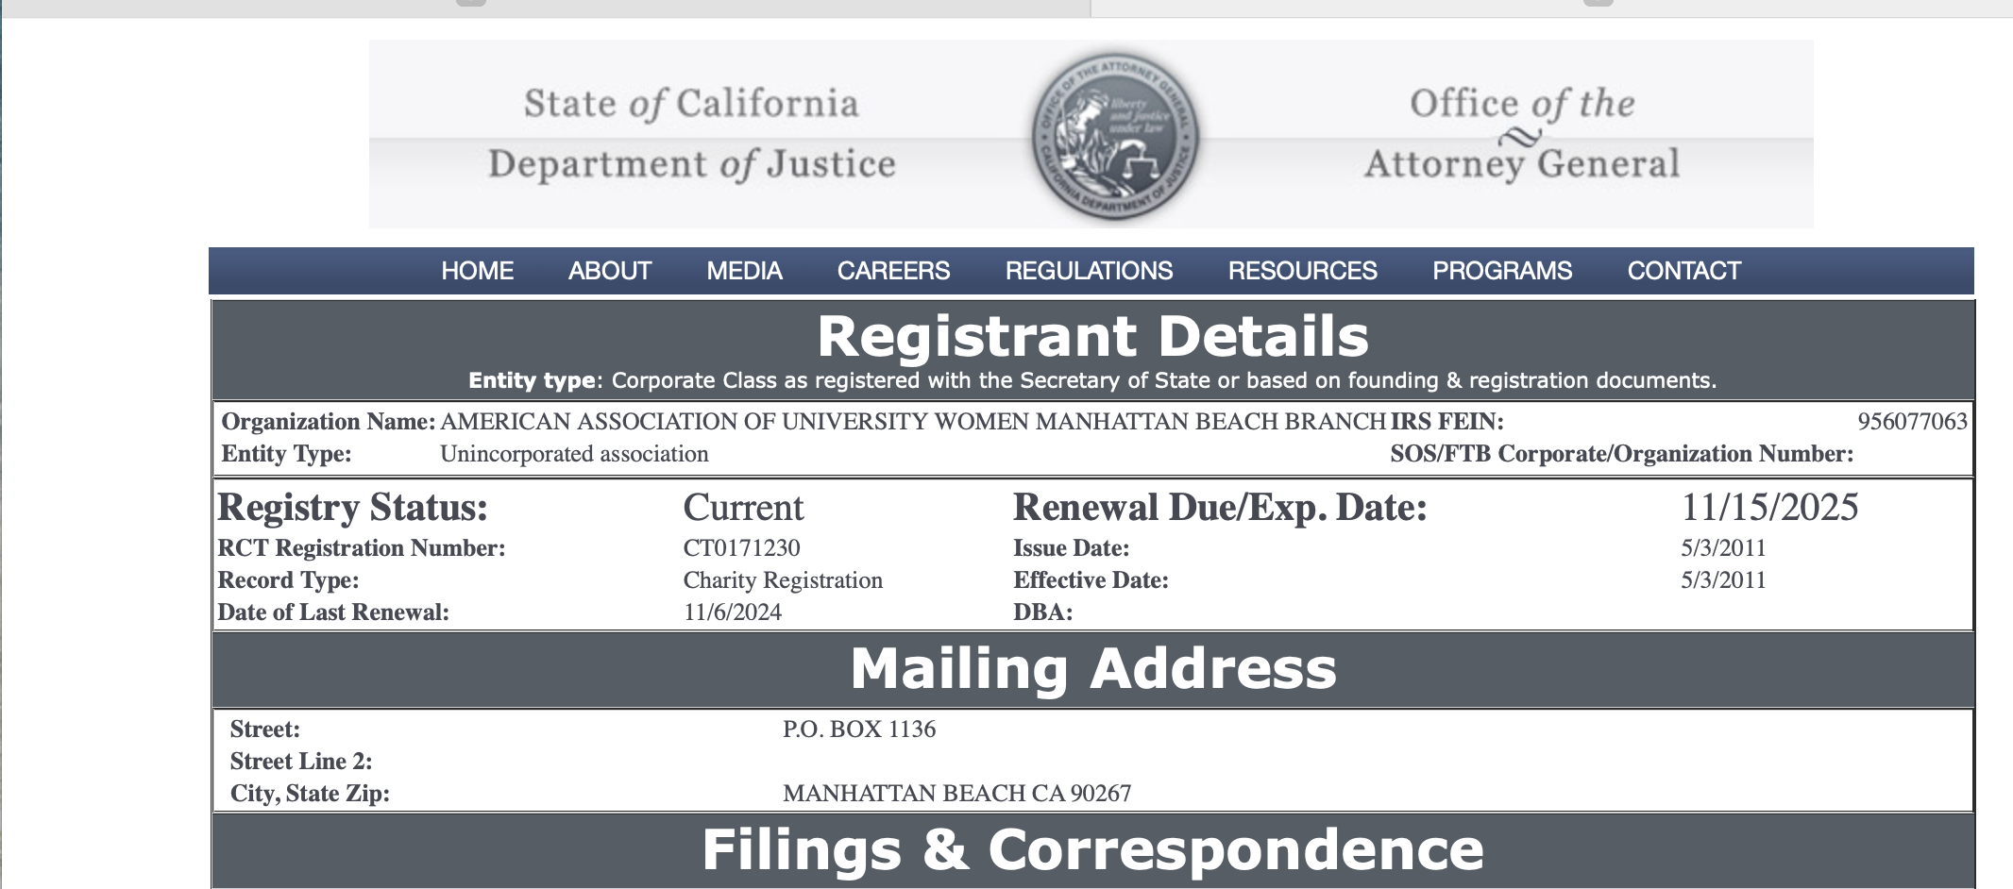
Registry Search Tool – three

Slide 35
What if My Branch Charitable Status has been suspended?
Call 916-210-6607 at the California Department of Justice to speak with Registry staff during normal business hours (8 am to 4 pm,) or leave a voicemail if you don’t know why your branch has been suspended.
Watch the Delinquency Webinar which provides step by step instructions for remedying a delinquent status. The webinar also includes the filing requirements, details about Form RRF-1, and how to check an organization’s status using the Registry Search Tool. Go to: https://www.youtube.com/playlist?list=PLZldm5UisZ7g-JGfwM4sv8PhZ44CpFW_E to watch the California Department of Justice YouTube webinar which runs about 17 minutes.

Slide 36
California Dept of Justice Webinars for the registration of charities and fundraisers
The California DOJ website has many webinars to assist you, including:
  Annual Registration Renewal
  Completing Form CT-TR-1
  Registry Resources & Website Navigation
  Raffles
  Initial Request
  Delinquency
  Dissolution & Withdrawal

Slide 37
Branch consolidating/Disbandment Process – Sharyn Siebert
Branches may consider joining or consolidating with another branch or branches. This entails a multi-step process that requires completion of multiple forms, approvals and filings with AAUW National, the IRS and California.
AAUW California Branch Support will work with the affected branches with the goal of preserving the branch or assisting the branch in adjusting the governance structure through revitalization, merger or disbandment.
AAUW California will maintain a copy of forms submitted and monitor the completion of required steps.
The “Branch Merger/Disbandment Process” pamphlet will be included in the Finance Peer Group session documents for the April 3, 2025 session.

Slide 38
Memorandum of understanding
The Memorandum of Understanding (MOU) should address the following items.
  Dispersing funds either in the merging (disbanding) branch’s account
  Dispersing funds on deposit with CA SPF
    Tech Trek
    Speech Trek
    Gov Trek
    Scholarship
  Board composition
  How AAUW California projects (Speech Trek, Tech Trek, Gov Trek) will be handled in the new branch.
  How special interest groups will move forward.
  How local scholarships will be handled.
  Disposition of members.

Slide 40
Q & a
Questions?
Carol will read the questions from the Chat.
We encourage Peer Group participants to join in with their suggestions and experience with the topics of this evening’s session.
More questions? Now’s the time to raise your hand.

