Slide 1


How to be a Branch Treasurer - Key Topics:
Budgeting and financial review process,
Monthly reporting and accounting system options,
California sales tax,
1099 reporting,
Q& A
Notes:
Welcome everyone, introduce Finance Committee, emphasize Q&A

Slide 2
Polling Questions -
Tell us about your branch
What is the membership of your branch?
1-50
51-75
76-125
126-175
176-300+
Does your branch sell merchandise?
Yes
No
Considering it
Not sure
What system do you use to record and report financial transactions?
Manual ledger
Excel spreadsheets
Quicken
QuickBooks
Other
Do you have silent auction fundraisers?
Yes
No
Considering it
Not sure
Notes:
Announce results of poll

Slide 3
Board Responsibilities for Effective Fiscal Management.
The board reviews and discusses thoroughly the annual operating budget of the organization prior to approving it.
The board takes advantage of the budget process to consider the most effective allocation of limited resources.
The board receives financial reports on a regular basis that are understandable, accurate and timely.
The board requires an annual review or audit by an independent entity – a committee or person who is not involved in the fiscal management of the organization. The board considers all recommendations made in the report and management letter.
Notes:
1) Generally, two positions are required for a branch to function – the President and the Finance VP/Treasurer. A Secretary is required if the branch is incorporated.
2) Review, if branch manages < $2 million, audit if >$2 million. 3) Key financial questions to be addressed.

Slide 4
Branch Finance Officer Responsibilities
Work with your board to evaluate the financial health and stability of your finances, develop a budget that supports the programs and activities of your branch and support a financial review process
Prepare monthly financial statements and include analysis of actual performance against budget.
Be aware of relevant federal and state charitable tax issues and legal liabilities.
Retain in good order all financial statements, IRS forms and correspondence, sales and use tax certificates, tax determination letters, paid checks, deposits, contracts, and other financial supporting documents consistent with best practices and state laws.
Adhere to all local, state, and federal charitable tax laws and generally accepted accounting principles and practices.
Notes:
It’s a lot of responsibility. And just what are generally accepted accounting principles and practices anyway???

Slide 5

Fundamentals of Budgeting
Why prepare a budget? It’s your branch plan for setting priorities and achieving goals.
When to prepare a budget? Ideally, the budget process should begin 3-6 months prior
to the end of the current fiscal year.
How to prepare a budget? Work with your leadership to prepare a preliminary budget that specifies the programs and activities the branch wants to run, and the budget requested. Appropriate board members, committee chairs and members should work with you to provide the budget figures for revenue and expenses for which they are responsible and explanations if needed.
To prepare the budget, gather historical information on the general operating costs, programs, and projects from previous year(s) and list the expected revenue and expenses for the branch and its programs.

Slide 6
Typical Budget Lines
Each branch will have different priorities and budget lines. Typical accounts are:
Revenues: Dues, fees, fundraising income for projects, directory advertising.
Expenditures: Postage and post office box rental, insurance and the Fund allocations, advertising and promotion, website hosting, membership directory and membership recruitment, program events, room rental, speaker fees, Zoom license, government filing fees.
Preliminary budget – by the current board prior to current year-end.
Final budget – by new board in September after summer planning meeting in July or August of the new fiscal year.
,
Budget
Budget Approval
Prepare
Prepare a report with the total and supplementary budgets for individual programs and branch operating costs.
Include
Include historical information on revenue and expenses.
Ask
Ask other officers and program chairs to review your budget carefully.
Present
After the budget has been reviewed and revised where necessary, present it to the branch board for approval.
Remember
Remember – and communicate with the board and all budget contributors, a budget needs to be workable!

Slide 7
Sample Budget

Slide 8
Financial Review
It is highly recommended that your branch financial records be reviewed each year. A financial review assures the members and the general public that the funds given have been used for their intended purpose.
If your branch is large, consider hiring an accountant to conduct the review.
If your branch is smaller, the branch president can appoint a committee of several interested members to do a volunteer member review. The current Finance Officer should not be a member of the review team but should cooperate as needed.
The reviewers should examine:
Bylaws and any bylaws changes since the last financial review
Minutes of all meetings
Financial procedures for developing the budget, signing checks, and approving unbudgeted expenses
Bank statements
Receipts and disbursement or computer printouts for these items
The final financial statement for the fiscal year
Receipts and disbursements connected with fundraising activities

Slide 9
Financial Review, continued
The reviewers will check:
Receipts on the books against the bank statements to ensure that there were no long delays between receipt and deposit
Paid checks against the checkbook and cash disbursement ledger to ensure that checks were signed and supporting documents for each disbursement were included
Account reconciliations, including checks more than six months old that have not been cashed
Assets and liabilities
Form 990, 990-EZ, or 990-N filing, California 199 or 199-N, RRF-1 and CT-TR-1 + other forms as required to be filed by branch
The financial reviewers should present a brief report to the membership or board, stating their findings, and certifying that to the best of their knowledge, the accounts and practices are correct and kept according to generally accepted accounting principles and practices.
Notes:
The review and procedures are not comprehensive. What procedures have been done by branches?

Slide 13
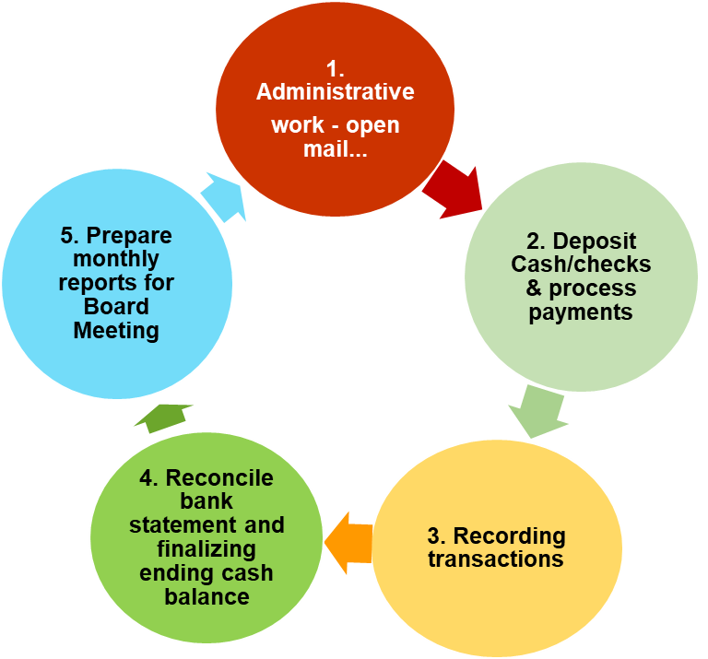

Slide 20
California Sales Taxes
(Yes, Nonprofits do pay them!)

Slide 21
When are sales taxes required? Publication 18 includes information for non-profit organizations
For most tangible property sold – T-shirts, Tote Bags, Books, etc.
Auction sales of goods are also taxable for the full amount of the sale price
Look carefully at tax rules if selling food items
  Is it cold or hot?
  Is it a beverage, and what kind?
  Is it designed for consumption “on site”?
  Also consider extensive health regulations of food sales
Fundraising events with a price including food and entertainment require special record-keeping

Slide 22

Publication 18
from the California Department of Tax and Finance Administration
For food specifics – See pages 25 – 29
For sales of items – See pages 36 – 39
Use CTRL+Click to download this publication
Publication 18, Nonprofit Organizations
https//www.cdtfa.ca.gov/formspubs/pub18.pdf

Slide 23
How to pay Sales Taxes
Apply for a Sellers Permit
  3 or fewer sales events per year – temporary permit for each
  Regular permit may be easier
  Online Services (ca.gov) www.cdtfa.ca.gov/services/#Register_Renewals
Collect Taxes – most branches include tax amount in sales price – be sure to let customers know
Remit Taxes with a Sales and Use Return – generally once each year – online or using form www.cdtfa.ca.gov/formspubs/cdtfa401ez.pdf
State will collect local sales taxes and remit to cities/counties – to see tax rates
www.cdtfa.co.gov/taxes-and-fees/rates.aspx

Slide 24
1099 Reporting
Purpose of Form 1099
  To report certain transactions to the Internal Revenue Service by business entities such as partnerships, associations, corporations and sole proprietorships, including all nonprofits.
  For payments to individuals, partnerships, associations, sole proprietorships, but not corporations.
  Payments of $600 or more must be reported on form 1099.
  Based on cumulative payments made within a calendar year.

Slide 25
services
Types of services that may require reporting by a branch on a 1099NEC:
      CPA, Tax Services or Bookkeeping services,
      A speaker for a program,
      Entertainment, such as musicians.
Types of services that may require reporting by a Branch on a
1099 MISC:
      Attorney Services.
      Rent
  Must = or exceeds $600 in any calendar year,
  Paid to an individual, partnership, association, sole proprietorship or other non corporate entity.

Slide 26
Rent
Types of rental payments that may require reporting:
  Office space,
  Venue for a program,
  Other types of rent such as:
    Equipment,
    Booth at an event.
  Must = or exceeds $600 in any calendar year.
  Paid to an individual, partnership, association, sole proprietorship or other non corporate entity.

Slide 27
Awards and Prizes
Types of awards & prizes (if they = or > $600 in any calendar year):
Cash,
Noncash payments for meals, lodging, travel etc. to attend a program,
Awards such as NCWSSL travel are reportable on Form 1099 MISC when the branch makes the payment.
IRS -Scholarships are defined as - payments to a candidate for a degree at an eligible educational institution for eligible expenses - and are nontaxable and non reportable on any 1099 – if all IRS requirements are met.

Slide 28
Reporting Awards
Tech Trek
For contributions passed through directly to the Special Projects Fund AND the Branch is not recording the revenue, and NOT making the payment for the award then the award is being paid for by an individual donor. Individual donors do NOT have a reporting requirement using Form 1099.

Slide 29
How to Report Payments
The following 1099 recipient information is necessary for all 1099s:
Name,
Address,
TIN.
1099 MISC:
Rent payments go in box 1,
Other payments go in box 3 - this would include prizes and awards.
1099 NEC:
Payments for services go in box 1.

Slide 30
Filing and Due Dates
1099 MISC
  You must use a scannable 1099 MISC (Copy A),
  Copy B for recipient can be a copy of Copy A,
  Recipients copy must be mailed by January 31st,
  The scannable 1099s plus the scannable 1096 must be mailed to the IRS post marked by no later than February 28th.
1099 NEC
  Same requirements as 1099 except that they must be post marked to IRS no later than January 31st.
Must accumulate the number of 1099 MISCs and NECs that you are filing and report on a scannable 1096.
If you issue 10 or more Form 1099 MISC they must be e-filed effective January 31, 2024, for all 1099s issued for 2023.

Slide 31
Irs form 1099 MISC. obtain from:
1. IRS
2. local business supply stores
3. Post office
4. Online must be scannable redlined form
https://www.irs.gov/pub/irs-pdf/f1099msc.pdf
Notes:
Control Click to View form and information

Slide 32
Irs form 1099 NEC obtain from:
1. IRS
2. local business supply stores
3. Post office
4. Online must be scannable redlined form
https://www.irs.gov/pub/irs-pdf/f1099nec.pdf
Notes:
Control Click to view IRS Form and information

Slide 33
Irs form 1096 obtain from:
1. IRS
2. local business supply stores
3. Post office
4. Online must be scannable redlined form
https://www.irs.gov/pub/irs-pdf/f1096.pdf
Notes:
Control Click to view form and information

