Slide 1
AAUW California
Public Policy
“School Board Project”
LA IBC - June 23, 2023

Slide 2
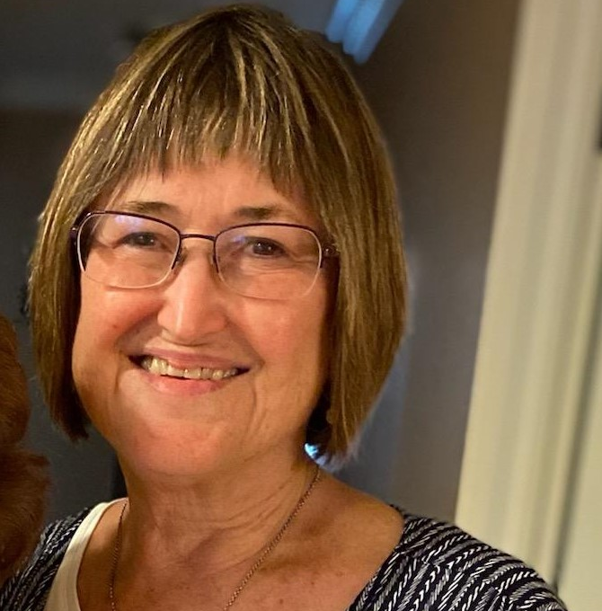
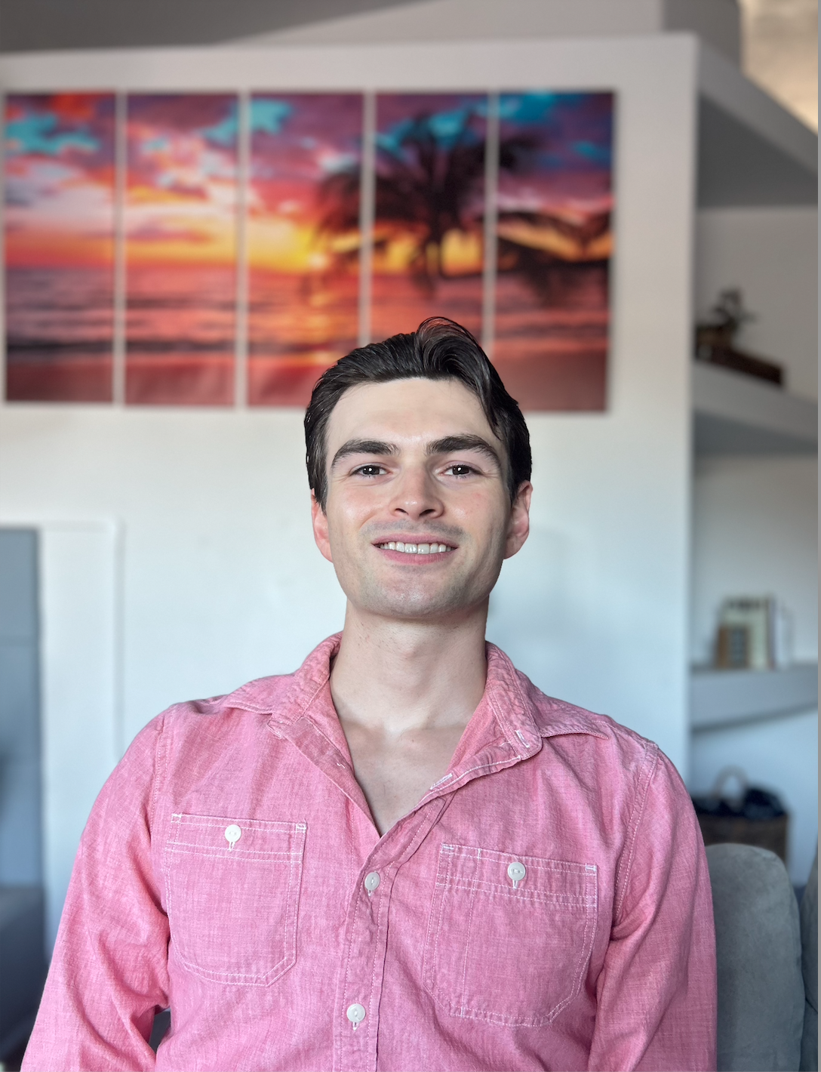
Presented By:
Kathi Harper
Public Policy Director - AAUW California
Samuel Turley
Civic Engagement Associate - Equality CA

Slide 3
Agenda - What We Will Cover
What is the Issue?
Who is Equality California?
How Can AAUW California members help?

Slide 4
What is the Issue? Book Bans by the Numbers: 26 states 86 school districts 1100 books

Slide 5
The Issue
Report: 350+ Books Banned in Florida School Districts Since Last July
Miami New Times, APRIL 25, 2023
ALEX DELUCA
Approximately 41 percent of the banned works featured LGBTQ themes, main characters, or significant supporting characters. Characters of color made up 40 percent of the main or significant secondary characters, while 21 percent of the titles dealt with racial and racist topics.

Slide 6
Texas Senate Passes Bill Removing MLK, Suffrage From Required Curriculum
The bill also removes requirements to teach that white supremacy
and the Ku Klux Klan are “morally wrong.”
By Sharon Zhang , TRUTHOUT Published July 19, 2021
Gov. Reynolds signs law banning LGBTQ instruction, school books that aren't 'age appropriate'

Slide 7
Parents rally outside a Glendale Unified School District (GUSD) Board of Education meeting on June 20, 2023 in Glendale, California.
NBC News

Slide 8
TEMECULA SCHOOL BOARD MEETING ERUPTS IN CHAOS FORCING LAW ENFORCEMENT TO STEP IN
HITC, Disha Kandpal
Wed 14 June 2023
Temecula Valley’s school board’s recent meeting erupted in chaos with parents and teachers screaming while discussing the board’s previous month’s decision to ban a social studies book that talked about gay rights activist Harvey Milk.

Slide 9
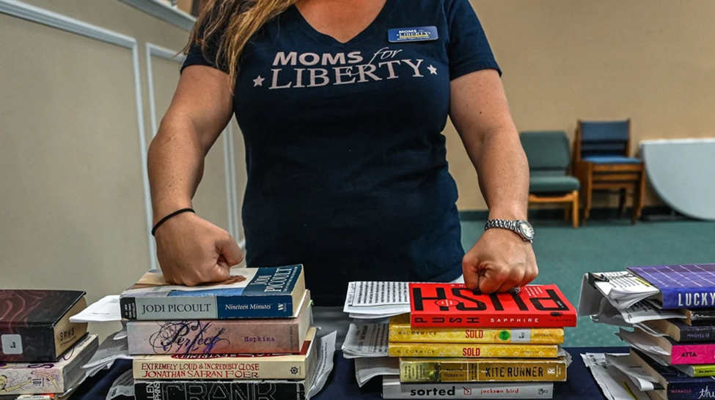
How Did We Get Here?

Slide 10
Since the group’s founding in Florida in 2020, its influence over local and national Republican politics has grown exponentially: It’s now a nation-wide movement with 260 chapters that claims to be a “grassroots” group working to protect students and defend parents’ rights. Its members are leading the charge on book-banning campaigns across the country and the group says it has helped install 275 of its favored candidates on school boards in 2022 alone, dozens of whom don’t have any children attending public schools in their districts.
VICE – David Gilbert, April 26, 2023

Slide 11
“Moms for Liberty” Start First California Chapter in San Luis Obispo County
By Contributed Article | May 12, 2021
Locally, a group of moms have joined “Moms for Liberty,” launched in January 2021 by two moms, both school board members, in Florida. This is a non-profit, non-partisan group promoting a return of power to the parents and the freedom to choose in what manner their children will be educated.
There are more than twenty new chapters of “Moms for Liberty” across the country, with the first California chapter right here in San Luis Obispo County. The group is looking for more interested local moms to start sub-committees, attend school board meetings, meet with board members and work toward getting the word out that parents truly can have a say and a choice in how their children are educated.
Paso Robles Press

Slide 12
Who is Equality California, and what are they trying to do about it?

Slide 13
Why is AAUW California Involved?
Added to PPPs 2023-2025:
“Access to diverse staff and curriculum that represents historically accurate information”

Slide 14
How Can AAUW Members Help?
Results of May 2023 Branch Survey
Replies | Branches | Current Issue | Possible Future Issue | Want to Help | Willing to Recruit | Branch Would Endorse | School Board Mtings
72 | 58 (49%) 220 School Districts | 13 Yes 6 Maybe | 8 Yes 21 Maybe | 27 Y 32 M | 23 Yes 31 Maybe | 37 Yes 30 Maybe | 12 Current 25 Future Y 26 Future M

