Slide 1
Overcoming Political ‘Overwhelm’
…But NOT giving up
Peg Carlson-Bowen
AAUW San Jose
Public Policy Chair
April 2018 AAUW CA Conference
Notes:
Many people have only recently become more political; many have been for years, but the need now feels more urgent.
We want to answer the question: How can we continue to be active, but not overwhelmed?
Many feel that the policies AAUW supports are under attack and the legacy women have built is in danger of being erased.
Avoiding overwhelm is easy, if you’re willing to give up, and if you do some research on this topic, some will simply tell you to sign off all your news feeds. We want to find a middle ground.
I’m not willing to give up and sacrifice the legacy of those on whose shoulders we stand, and the fact you’re here means you’re not either. Welcome.

Slide 2
Agenda
Where Are You?
What’s Important to you?
How to Manage
Taking Action
Letting Go
Notes:
Here’s our agenda for the session.
Let’s figure out what your current experience is like—where are you right now (and wherever that is is okay). We want to address your needs where you are.
Next, how can discover your true priorities, what is important to you? We’ll have an exercise to sort through the many demands on your activism.
Once we’ve narrowed the field a bit, we’ll talk about how to deal with everything coming at you.
When we have a manageable amount to deal with, we’ll narrow action down to what’s essential, effective and considerate of your time, including a few technical tools that will do a lot of the work for you.
And then we’ll deal with how to create space for you so that your activism can fit into a sane life.

Slide 3
Political Overwhelm Life Stresses
This workshop is not this
Notes:
There are plenty of people who can teach you about general stress relief—that is not this presentation. Our focus is specifically on how to manage the activism you feel you want to take on in your life.
This is not a guilt-fest, meant to push you to take action; because you are here, I assume you want to be active.
As Heather Heyer said, ‘If you’re not outraged, you’re not paying attention.’ (In case you have forgotten, Heather Heyer is the young woman run over and killed by a white supremacist in Charlottesville, VA last year.) Whatever your political stance, there are probably issues compelling you to act.
I’m hoping these techniques will allow you to pay attention without becoming paralyzed by despair. Action is the antidote to despair: Joan Baez
These techniques come from various sources—we hope you find something that suits you and your life. If not, we encourage you to keep looking.

Slide 4
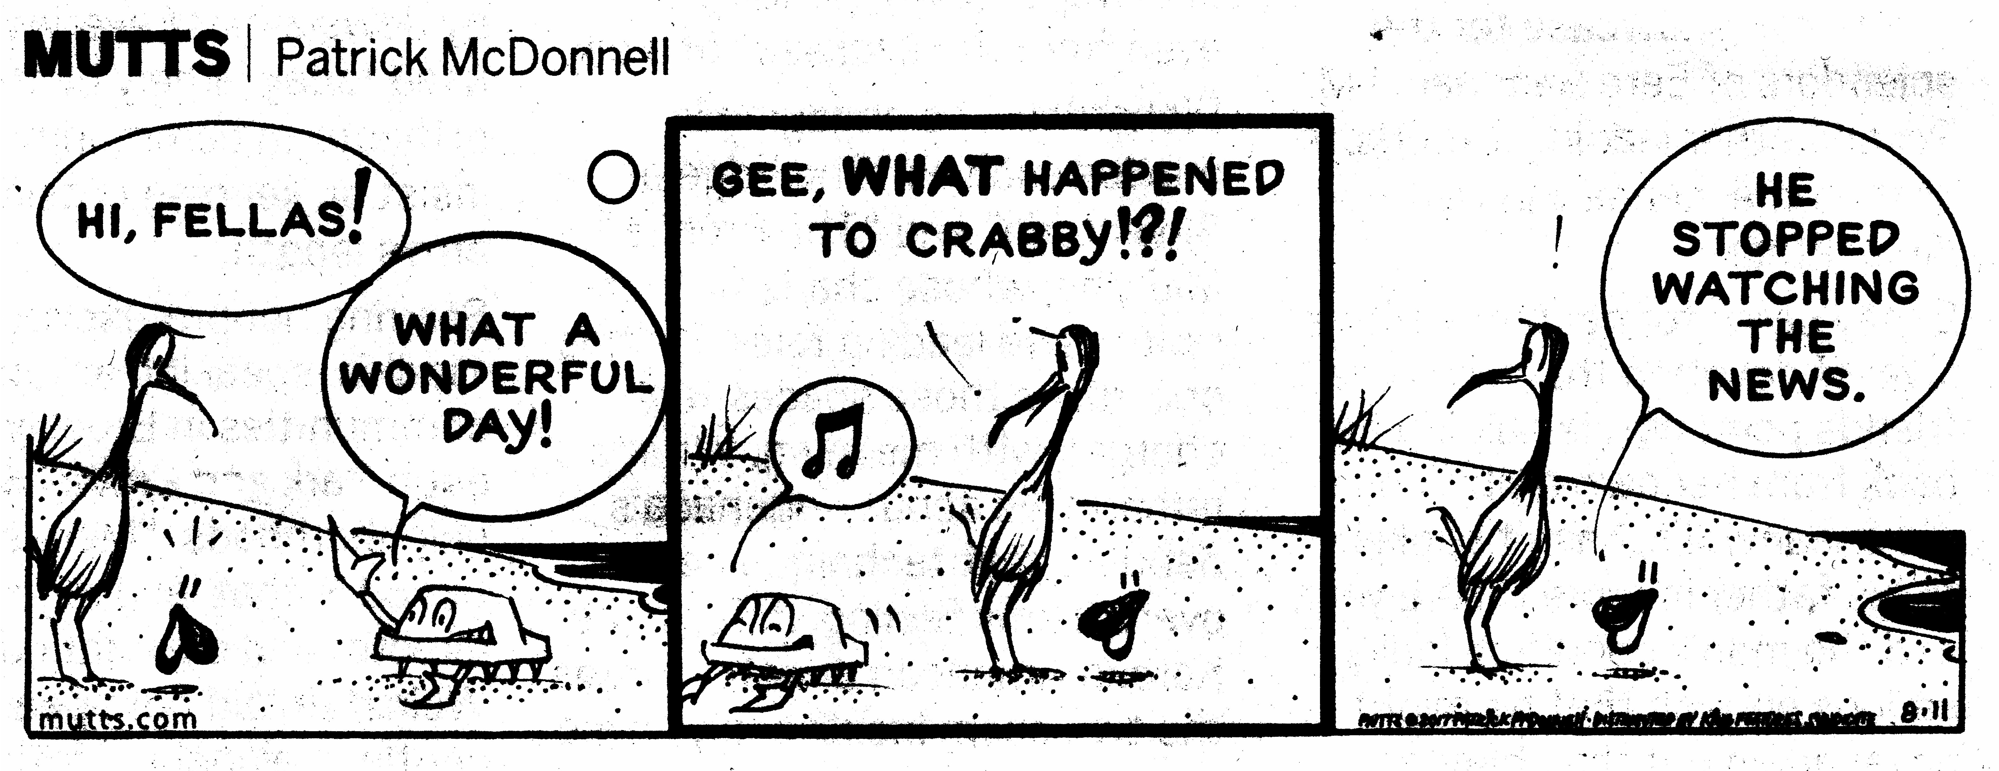
Overwhelm Chronic Stress
Adverse Health Effects
Irritability
Lack of Agency
Helplessness
Indecisiveness
Social Withdrawal
Sleep Disturbance
Negative Self-Talk
Notes:
Though this is not a general stress workshop, being overwhelmed, or being paralyzed not knowing what to do can translate into chronic stress.
Question: How many of you have felt stressed by the results of the election: no matter who you voted for?
A report released in February of 2017 by the American Psychological Association said that the political climate is a very or somewhat significant source of their stress and close to half of Americans say the outcome of the election causes them stress. 72% of Democrats surveyed said that the results of the election were a significant source of stress, while 26% of Republicans said the same. But overall, 2/3 of people said they were stressed about the future of the country, including nearly 60% of Republicans and 76% of Democrats.
People with more than a high school education were more likely to report stress related to the election outcome compared to people with a high school education or less. People in urban areas also reported more election related stress at 62%, followed by people living in suburbs (45%) and rural areas (33%). (These rural numbers may have changed since the imposition of trade tariffs, if feedback from my farmer relatives in the Midwest can be generalized).

Slide 5
Where are you now?
Are you here?
Or here?
Notes:
First, let’s talk about where you are. There are a couple of ways that you might be experiencing politics. You may have dived in, or you may have retreated to the beach café, worried about drowning in a rip tide if you even put one foot into the water…..
No matter which experience you are having, some of the following may apply:
-Do you feel like there’s so much information and so much to do that you’re paralyzed?
-Do you question which news source is giving you correct information, and don’t know who to trust?
-Are you new to political activism and feel like you don’t know enough about how it ‘all works.’
-Do you just feel like your one voice won’t make a difference?
-Do you see veteran ‘newsies’ or ‘activists’ setting a standard you just can’t meet?
-Or are you a political or news junkie that needs a 12-step program?
You marched, but worry that that pink hat will go into the closet like a bridesmaids dress and never be worn again.
Whether your personal views are leading you to decry policies that are being proposed or defend methods being proposed.
We’re not from the government, but we’re here to help.

Slide 6
What’s
Important
To You?
Notes:
It seems like everything is blowing up at once…..and you feel like you have to act on every issue. But you know that this isn’t going to be sustainable....
You CANNOT do everything well! (Not if you expect to also maintain family relationships, perhaps a job, and your health and sanity!)

Slide 7
What’s Important
War
Equal Pay
Campus Sexual Violence
Voting Restrictions
LGBTQ civil rights
Title IX
Healthcare for all
Gender Equity in the Workplace
Social Security
Getting more women elected
Access to/cost of Women’s Healthcare
Immigration
Deficit Spending
Student Debt
Human Trafficking
Reproductive Rights
Gun Violence
Notes:
If you’re anything like me, this is how you feel after you watch the first few minutes of the morning news show. (I think this is actually a photo of me that my daughter took and photoshopped…)
Yes, everything is important, but we need to ‘pick our battles.’ This is a hard one for me, but I had a wise woman who loved me tell me, “Peg, love, the sun will come up in the morning EVEN IF you are not there to pull it up over the horizon…”

Slide 8
Priority Triggers
Ask yourself:
Is your attention drawn immediately when you see news about this?
Do you have a personal connection to it?
Do you ‘high five’ or ‘fist pump’ when you see progress?
Can you build a community around it?
Rank 1 to 6*
*Each item can only have one number!
Notes:
Exercise:
(We have given you two cards: on the first card) write down up to 6 topics that you are concerned about—I will give you two minutes to think about that….
Now that you’ve written those down, rank them 1 to 6---there can be only ONE 1, etc. – I’ll vige you a minute to do that.
Transfer your lower ranking items to the second card, in any order
We’re going to collect those cards…… (or should we just have people tell me a lower ranking one---might be more efficient…..)
Someone please give me one of their lower ranking topics…….does anyone have that in their top priorities?

Slide 9
Priority Exercise

Slide 10
Trust can lead to….
Letting go
Unburdening others
Notes:
This is really a question of trusting each other and letting go….confronting some of our trust issues. Do you trust like-minded people to do a good job advocating for the issues you care about?
Have you considered incorporating a ‘team’ model into your thinking—allowing yourself to let go of the reins a bit just play the position they need you to play when you need to play it (like attending a march, or contacting your legislator at just the right time?) Or have you considered getting an advocacy partner, who can take responsibility for advocating for one issue, while you advocate for others—keeping each other informed so you can let go of the guilt?
If you heard somone else’s priority that matched your same top concern, know that you are unburdening another person.
If one of your lower ranking priorities is someone else’s high ranking priority, trust that that person will serve the cause well.
If your priorities remain, you may want to keep them for a later time—do not take these causes back up now—keep them for when you meet someone who is addressing them, or for a time when you have enough bandwidth to take them on.

Slide 11
Add Self-Care

Slide 12
Quality,
Not Quantity
Notes:
Clay Shirky, a technologist, stated this in 2008. It hasn’t gotten any better, and the news cycle has made it worse.
Now that you have your priorities, how do you manage them? What are the practical steps to not becoming overwhelmed with information and action items? How can you fit what can essentially be a second job into your life?

Slide 13
Dealing with News
Does this relate to my top three?
Do I already know this?
Is this item too recent?
Is this conjecture, opinion, or analysis?
Your attention = $$$$ for news outlets
Notes:
When watching the news or your newsfeed, reading Facebook or Twitter, looking at a newspaper, listening to the radio, ask these questions.
If this does relate, pull out your card and write a note, and deal with it when you can if you can’t deal with it immediately (prevents getting ‘sucked in’)
If you already know it, why are you reading, watching, listening to it? Do you ever really find out a LOT more that will change your mind or your actions?
If it just happened, no one really knows much about it….let it go until more is known. You’ll waste a lot of time here!
Is what is being said conjecture (just a guess really), opinion (if so, do you respect the person’s opinion?), analysis (tying together disparate facts or occurences to make sense of them), or news (actually new information you DIDN’t know before)?

Slide 14
Consider the News Source
Progressive
Conservative
Note: Whatever the slant, this is too many sources.
Notes:
Another important question when deciding what to look at: Is this a source I know? Is this a source that will give me unbiased new information I will accept and respect?
There’s a lot of advice recommending that people get news from a variety of sources, but if you don’t respect the source, it’s a waste of your time.
Actually, depending on your political bent, late night entertainment actually covers some serious topics and helps to make it light.
There are some organizations who are ‘rating’ news sources, such as AllMedia.com, and some apps, such as CapitalCall, which allow you visibility into what others consider the ‘slant’ of your news source. These can help you get a less slanted view, but all things contain bias—a perfect solution doesn’t exist. Don’t spend hours looking for it.

Slide 15
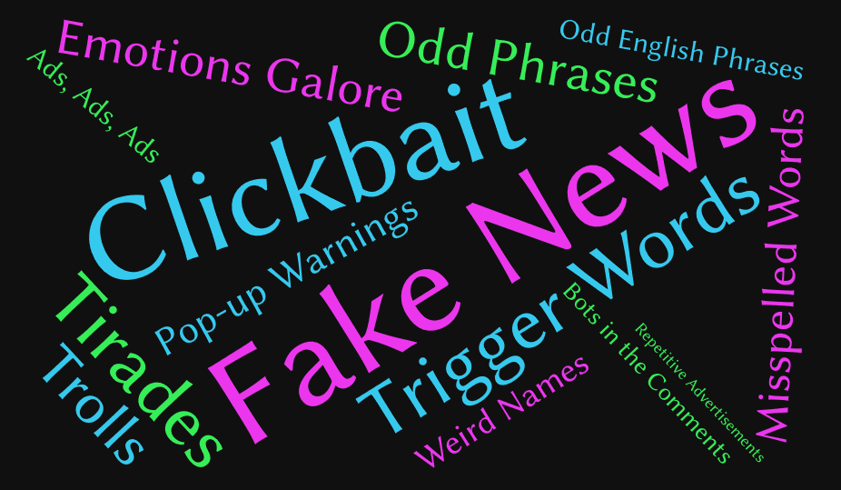
Social/Anti-Social Media
Don’t read the comments
Okay, so you read them– don’t respond
Watch your emotional temperature
Identify your trigger words
DVR the news…and use fast forward
Online communities to provide support
Rationing: odds and evens
Notes:
The comments section of any social media: Do you know this person? You may be talking to a Russian teenager (and having lived with two of them, I can tell you they can be irrational)
When you’re on a site, take your emotional temperature---is what you’re feeling right now going to make you an effective advocate? Is your sarcasm quotient rising? Will you feel better about yourself after you hit ‘post?’
In order to keep your priority filters going, consider DVR’ing the morning news. (If you don’t have to check the traffic conditions or weather). Listen to it later; fast forward is your friend!
There’s a lot of advice out there to avoid social media altogether, but many groups are formed and advertise their events there---the Woman’s March wouldn’t have happened without it, and many say that that is the most encouraged they’ve been in a while.
If you can’t deal with social media every day, try rationing it. Odd days on, even days off. MWF, weekdays only, weekends only. Whatever it is, give yourself permission to skip it. It’s okay.

Slide 16
Successful social movements don’t win by convincing the fringes, but by finding common denominators.
Successful Non-Violent Social Movements Course,
Harvard University
Notes:
It’s like teaching a pig to dance….everyone ends up covered in mud, and the pig just gets annoyed…..

Slide 17
Handling Incoming Appeals
Sign this petition
Send this pre-formatted letter…
Join a group…
Start a new organization…
Give money…
Contact your legislator
Notes:
Beware of slacktivism (also slactivism) informal [MASS NOUN] Actions performed via the internet in support of a political or social cause but regarded as requiring little time or involvement, e.g. signing an online petition or joining a campaign group on a social media website or application.
Signing an online petition is a very low level of participation, and may not be regarded by legislators as impactful. If it is an organization that is well-regarded, identifies a specific action that is achievable, and aligns with your priorities, then it may be a good move. However, be aware that organizations, once you sign, may consider you a ‘member,’ may be gathering information about you to sell to other activism groups, may expect more involvement or a contribution down the line. I will talk about how these approaches can work well in a little while, but participate with awareness.
If you are asked to join a group, consider what benefits may come to you. First—as always—does it align with your priorities? Are you already in a similar group? Does this group have a very clear purpose, goal and method? Some online groups may do the drudge work of combing through legislation for you and pulling out the relevant, actionable items; some may organize events for you to participate in, some may provide you credibility (street cred) when you interact with elected officials or other organizations, some provide leadership opportunities, some provide others that simply help you feel like you’re not crazy…..
There are ‘levels’ of joining a group—if you follow an organization on Facebook, a website, a newsletter, or Twitter, this may be a way of avoiding news outlets—it may act as your ‘filter’ and so be useful to you, be accessible when you want/need it, and not demand much else.
If you are asked to start a new organization or join a very new organization, ask whether this organization is redundant to others or truly unique. Do you have the time and does the group have the staff and expertise to create the infrastructure that a new group requires these days? What are the funding requirements? Time requirements? Timing horizon?
If you are asked to give money (which most groups will ask), what is an approach that will align your giving to your values and to your budget? One way to handle this is to make a giving plan and set up monthly contributions—even small ones—so that your values are supported in a sustainable way.
The request to contact your legislator may be appropriate—or may be a waste of time. It is always appropriate to let your legislator know how you feel about an issue, HOWEVER, there are often announcements of proposed legislation that really will never see the light of day, and there are ways to time when you contact your representatives that are more effective than others. That being said, you can use technology to contact them efficiently and quickly. Also, there are groups that can help you ‘curate’ the timing of your actions, which I will talk about in a moment.

Slide 18
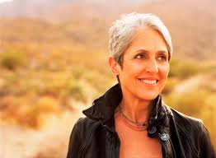
Act
“Action is the antidote to despair.”
Joan Baez
Notes:
Okay, you’ve gotten it down to your priorities, a minimal amount of incoming information, and you’re choosing what to do. What can make this easier, more efficient, and respect the time you have?

Slide 19
“Self-criticism is consistently associated with less motivation…. It is also one of the single biggest predictors of depression….”
First,
give up guilt
The Willpower Instinct: How Self-Control Works, Why It Matters and What You Can Do to Get More of It”
Notes:
I was talking to a woman working on a project that I KNOW will save lives. Literally. And she was beating herself up about not doing more. She has a passion for what she’s doing, and it will take a LOT to accomplish, so she actually won’t have time to do much else, I don’t think. What she’s doing is HUGE. But she felt she should do more….that guilt will not serve her or her project, as it will stress her out. Time to give it up!
“Study after study shows that self-criticism is consistently associated with less motivation and worse self-control. It is also one of the single biggest predictors of depression, which drains both "I will" power and "I want" power.”
“Surprisingly, it's forgiveness, not guilt, that increases accountability. Researchers have found that taking a self-compassionate point of view on a personal failure makes people more likely to take personal responsibility for the failure than when they take a self-critical point of view. They also are more willing to receive feedback and advice from others, and more likely to learn from the experience.”
From ‘The Willpower Instinct: How Self-Control Works, Why It Matters and What You Can Do to Get More of It” by Kelly McGonigal, PhD

Slide 20
It’s more important to get started than to succeed.
James Clear
“To overcome procrastination, find a way to start your task in less than two minutes….You don’t even have to finish….”
Notes:
“Psychology studies have also revealed that it is easier for us to stay in motion once we have started. Actually, what the studies show is that our human brains have a strong urge to finish tasks that we start. We don't like leaving things unfinished or partially done. This is a widely research phenomenon known as the Ziegarnik Effect, named after the Soviet psychologist Bluma Zeigarnik.”

Slide 21
Rethink Goals
Goals put happiness off into the future; pull rewards into the present
Micro goals help you start; small increments add up and produce more consistent results
Break tasks into easily achievable actions
Don’t push harder; remove more obstacles
Environment is more important than motivation
Set up processes and practice consistency
Don’t sacrifice the good for the perfect
Notes:
James Clear.com:
“If you completely ignored your goals and focused only on your system, would you still get results?”
“When you're working toward a goal, you are essentially saying, “I’m not good enough yet, but I will be when I reach my goal.” Choosing a goal puts a huge burden on your shoulders. Instead, you can keep things simple and reduce stress by focusing on the daily process and sticking to your schedule, rather than worrying about the big, life-changing goals.
“Systems-based thinking is never about hitting a particular number, it's about sticking to the process and not missing workouts. Systems are about the long-term process. In the end, process always wins.”
“Newton's First Law of Productivity
First Law of Motion: An object either remains at rest or continues to move at a constant velocity, unless acted upon by an external force. (i.e. Objects in motion tend to stay in motion. Objects at rest tend to stay at rest.)
In many ways procrastination is a fundamental law of the universe. It's Newton's first law applied to productivity. Objects at rest tend to stay at rest. The good news? It works the other way too. Objects in motion tend to stay in motion. When it comes to being productive, this means one thing: the most important thing is to find a way to get started. Once you get started, it is much easier to stay in motion.”
“Newton's Third Law of Productivity
Third Law of Motion: When one body exerts a force on a second body, the second body simultaneously exerts a force equal in magnitude and opposite in direction on the first body. (i.e. Equal and opposite forces.) If we want to become more effective and more productive, then we have two choices. The first option is to add more productive force. This is the “power through it” option. We gut it out, drink another cup of coffee, and work harder…. The second option is to eliminate the opposing forces…. If you reduce the unproductive forces in your life, your productivity will glide forward naturally. It's like you magically remove the hand that has been holding you back.”

Slide 22
Find Your Community
Advancing equity for women and girls through advocacy, education, philanthropy, and research.

Slide 23
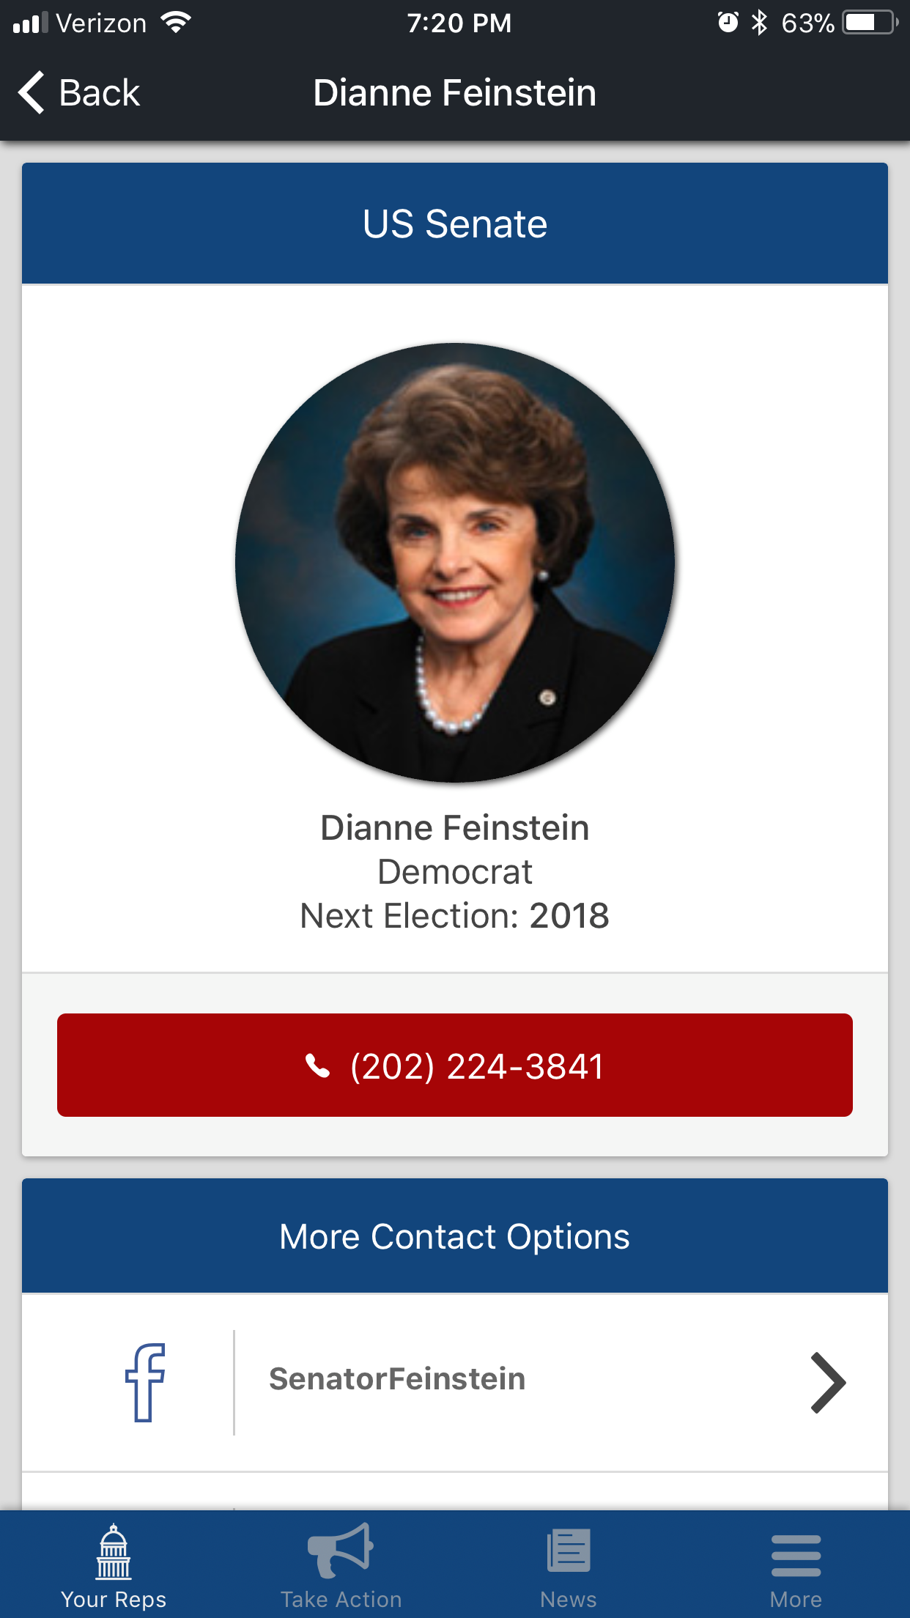
Leverage Technology
Notes:
Facebook Town Hall
To find and contact your elected representatives, click on ‘Town Hall,’ under the ‘Explore’ Menu on Facebook. This feature can also remind you of upcoming elections and allow you to ‘follow’ your elected representatives.
Resist Bot
To participate, text “RESIST” to 50409 on your Smartphone, and follow the prompts to set up a communication to your Senators and member of Congress. You can indicate which representative you wish to contact. A message will be sent via fax, email or letter, or you can elect to call their office. No downloads or apps required. This is also available now through Facebook messenger and provides suggested topics if you request them.
Daily Action
“To join, text DAILY to 228466 (A-C-T-I-O-N)
“Daily Action” is a text-to-phone call-based communication tool that provides a summary of an issue from a progressive point of view, then allows you to directly telephone the appropriate representatives’ offices.
5 Calls phone app: Progressive non-profit
“Type in your ZIP code (or let your browser or the app find your location for you).
Choose an issue that’s important to you and 5 Calls will give you a progressive script for a phone call
Some issues need calls to all three elected federal representatives (we’ll tell you when they do). For those, call the first person on the list. When you’re done, enter your call results and then move to the next person on your list.
5 Calls does the research for each issue, determining which representatives are most influential for which topic, collecting phone numbers for those offices and writing scripts that clearly articulate a progressive position. You just have to call.
Calls should take less than a minute. You’ll be speaking to a staffer, so make your point clearly so they can tally your opinion correctly. The provided scripts are useful but you can, of course, add your own words.
Capitol Call
Download the ‘Capitol Call’ app to your SmartPhone. Enter your info, choose your news sources. See your representatives voting record, contact them.

Slide 24
Act Local
Local can action may happen more quickly
Person-to-person contact changes attitudes
Local progress feels more ‘real’

Slide 25
Let Go
For Now…

Slide 26
When to Re-engage?
Calendar it….and let it go….
Notes:
Practice non-engagement

Slide 27
Thank You

