Slide 1
We will begin shortly
Dial into the Conference line for audio.
Dial In Number
877-885-3221
Password
7770040
Mute your audio
on
Google Hangout

Slide 2
Who’s Here?
 | Name | Branch
 | Beth Chodak | Bakersfield, California
 | Betsy Pollick | Gilroy, CA
 | Carol Anderson | Modesto/Turlock
 | Carolee Focht | Westminster-Fountain Valley-Huntington Beach
 | Cathy Foxhoven | California Online, San Mateo
 | Celine Osborn | Tustin
 | Dana Loury | North Tahoe
 | Dawn Johnson | Mariposa and AAUW California
 | DeAnna DZamba | Oakland-Piedmont
 | Dianne Owens | Lompoc-Vandenberg Branch, SBC IBC, Board of Directors
No | Elizabeth Guimarin | San Jose
 | Gail Chesler | Orinda-Moraga-Lafayette and Tech Trek Hopper (treasurer)
 | Heidi Scott | AAUW Marin
No | Jane Niemeier | La Mesa-El Cajon, San Diego
 | Name | Branch
 | Karen Dennis | AAUW Laguna Beach
 | Keri Then | Riverside-Moreno Valley-San Gorgonio
 | Laura Selken | Santa Maria, CA
 | Leann Roque | Palos Verdes Peninsula
 | Lenore Simon | Tustin-Santa Ana-Orange
 | Maddie Brown | AAUW Mariposa
 | Nancy | Visalia-Sequoia
 | Nancy Mahr | Palos Verdes, State Board
 | Pam Strayer | Laguna Beach
 | Patricia Watters | North Tahoe and Paso Robles
No | Penelope LePome | China Lake-Ridgecrest Branch
 | Ramona Raybin | San Mateo
No | Randa Blanding | La Mesa-El Cajon
No | Sally Hibbits | Thousand Oaks
 | Scarlett Wood | Healdsburg, Ca
 | Sharon Corbett-Parry | Del Mar-Leucadia
 | Shauna Ruyle | San Diego
 | Susanne Potter | Walnut Diamond Bar

Slide 3
Setting up a FACEBOOK account

Slide 4
Some Facebook basics
You have to have a personal Facebook page to start. You’ll be adding a “Page” to your account.
Page or Group? Start with a Page.
Facebook Page | Facebook Group
Gives you a public presence. Unlike your profile, Facebook Pages are visible to everyone on the internet by default. You, and every person on Facebook, can connect with these Pages by becoming a fan and then receive their updates in your News Feed and interact with them. | Groups allow people to come together around a common cause, issue or activity to organize, express objectives, discuss issues, post photos and share related content. Can be Public, require administrator approval for members to join or keep it private and by invitation only. Like with Pages, new posts by a group are included in the News Feeds of its members and members can interact and share with one another from the group.
February 22, 2018 – Sandi Gabe, AAUW Director, Communications

Slide 5
Setting up your account
Facebook Page Type | “company, organization, or institution” nonprofit organization
Name Format | AAUW “branch name” (CA) Branch. Try to make your name as close to the suggested format as possible. This will help make AAUW branch pages more searchable while showing the local presence and national reach of AAUW.
Branch Logos | Download from Member Services Database
Let National know you’ve created a Page | e-mail social-media@aauw.org so they can follow and support all of the great work that you do!
February 22, 2018 – Sandi Gabe, AAUW Director, Communications

Slide 6
My account is set up. Now what?
Post, Post, Post | As the creator of the Page, you are automatically the moderator. It’s useful to have at least one additional administrator for your page. (While anyone who likes your Page can post on your wall, only those users assigned as Page “admins” can manage all aspects of the Page, including posting to the Page as your branch, sending messages, creating ads, and adding additional users as Page admins or related roles
Set up a social media calendar | Consider assigning board members to post on a specific day of the month
Link your Facebook page | Embed your Facebook link into your website Link your social media accounts (twitter, Instagram) so you only have to post once
Get “likes” | Like similar pages. Ask your members to “like” your page. Ask them to invite their friends to “like” your page.
February 22, 2018 – Sandi Gabe, AAUW Director, Communications

Slide 7
When’s the best time to post?
If you have limited time to post, choose a consistent time and stick to it.
You can also “schedule” your posts ahead of time.
February 22, 2018 – Sandi Gabe, AAUW Director, Communications

Slide 8
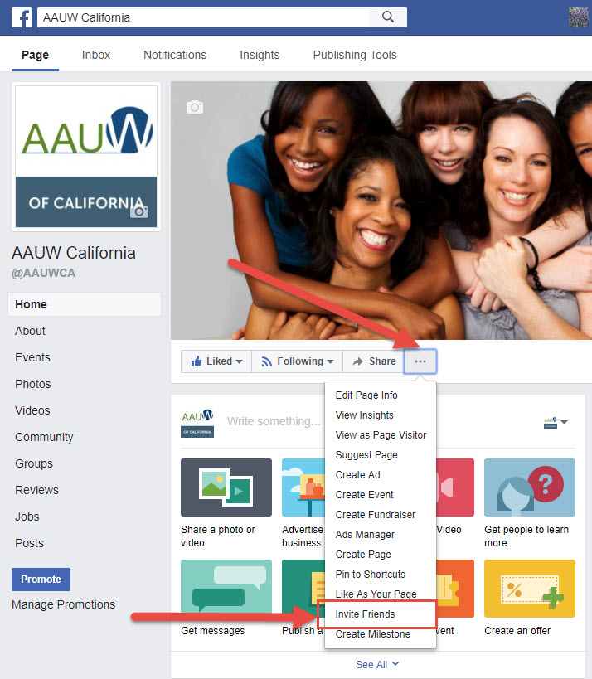
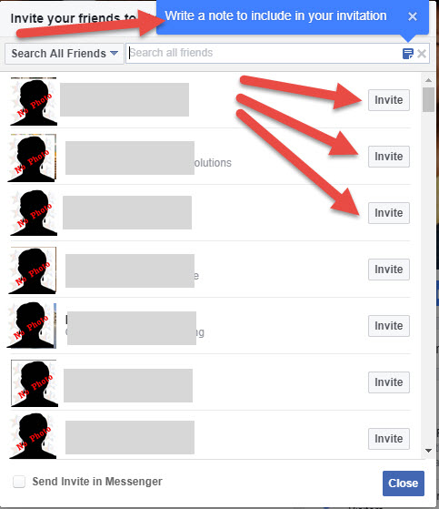
Getting more “likes”
February 22, 2018 – Sandi Gabe, AAUW Director, Communications

Slide 9
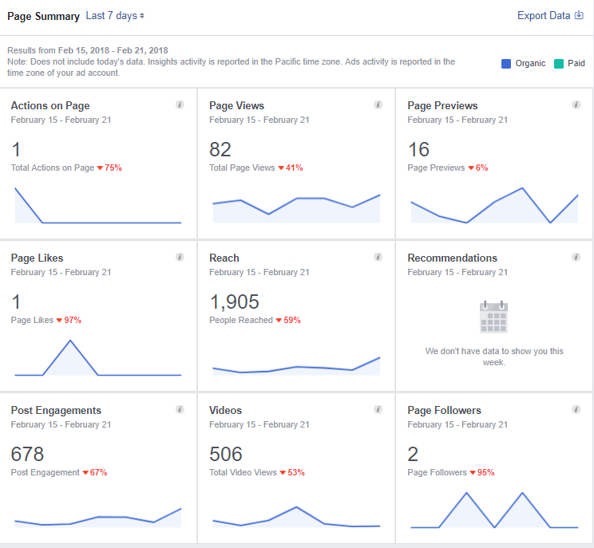
It’s not all about “likes”
Engagement is KEY
Likes, Shares, comments, reach
Ask members to “share” and/or comment on your posts.
Drive them back to your website for more information
Videos get the best responses
February 22, 2018 – Sandi Gabe, AAUW Director, Communications

Slide 10
Where can I find content?
Share content that you like from your own page.
Seek out other pages that have similar content.
Share URLs
Tag people (with their permission)
February 22, 2018 – Sandi Gabe, AAUW Director, Communications

Slide 11
Oh No! (We got a negative comment)
Do you have a social media policy for your branch?
Do you have a Facebook comment policy?
Educate your membership and public
Hide the bad comments
Ban specific words
Ban the user (last resort)
Resources:
https://marketingland.com/10-tactics-handling-haters-facebook169322
https://www.practicalecommerce.com/how-to-deal-with-negative-comments-on-facebook
February 22, 2018 – Sandi Gabe, AAUW Director, Communications

Slide 12
Sample Facebook comment policy
We welcome you and your comments to the Facebook page for [COMPANY NAME].
This site intends to inform and engage with the fans, friends, family members, and other businesses, entities, or interested persons of [COMPANY NAME].
You are encouraged to submit comments, questions, and concerns, but please note this is a moderated online discussion site and not a public forum.
Once posted, [COMPANY NAME] reserves the right to delete submissions that contain vulgar language, personal attacks of any kind, or comments we deem to be offensive or disparaging.
Further, [COMPANY NAME] also reserves the right to delete comments that:
Contain spam, advertising, solicitations or include links to other sites;
Are clearly off topic or disruptive;
Are obscene, vulgar, or sexually explicit. This includes masked words (***), acronyms, and abbreviations;
Are chain letters, pyramid schemes, or fraudulent or deceptive messages;
Promote particular services, products, or political organizations or campaigns;
Infringe on copyrights or trademarks;
Advocate illegal activity;
Violate any policies of [COMPANY NAME].
Please note that the comments expressed on this site do not reflect the opinions and official position of [COMPANY NAME].
February 22, 2018 – Sandi Gabe, AAUW Director, Communications

